Slide 1
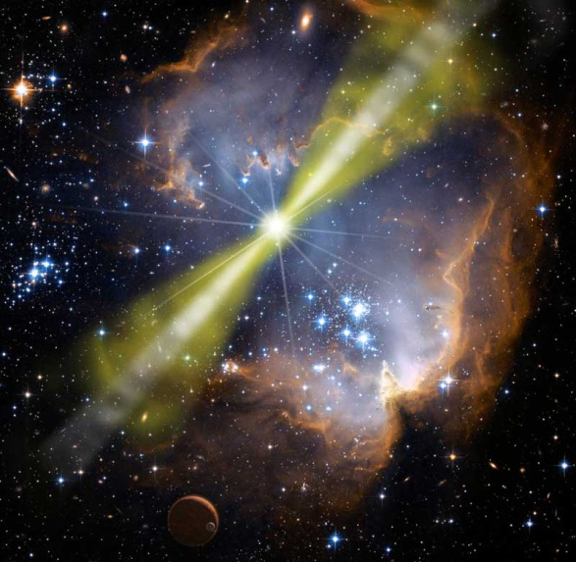
GW Memory from GRB Jets a possible DECIGO source
Ofek Birnholtz, Tsvi Piran
Racah Institute of Physics, Hebrew University of Jerusalem
arXiv:1302.5713v2, submitted to PRD
Yukawa International Seminar
Yukawa Institute for Theoretical Physics
Kyoto, Japan, 3.6.2013
Pat Hrybyk-Keith & John Jones
NASA/Swift/Mary

Slide 2
Gamma Ray Bursts’ Jets
Powerful Jets (~10⁵¹ergs)
High relativistic acceleration (100Γ1000)
Narrow (₀~0.1)
 Generation of Gravitational Waves

Slide 3

Memory & Collisions
Non-periodic source, displays a Memory (Zero Frequency Limit)
“The collision approximation”:
  N particles of masses m_{A}, velocities _{A}, Γ_{A}⁻²=1- _{A}², angle _{A} to observer.
Method:
  Numerical Integration
  Three models by increasing complexity:
    1. Point-Particle 2. Wide Jet 3. Acceleration
Favata 2010

Slide 4
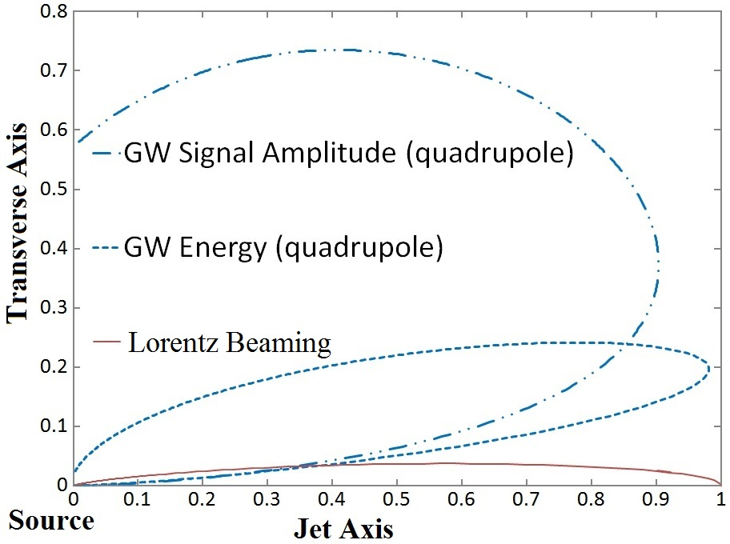
Anti-Beaming
Point Particle  Quadrupole, Anti-beamed
Signal amplitude peaks at angle ~Γ^{-½} off-axis
  as oppsed to EM radiation, up to ~Γ⁻¹
  Can we have joint detection?

Slide 5
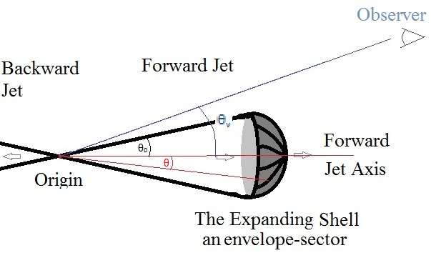
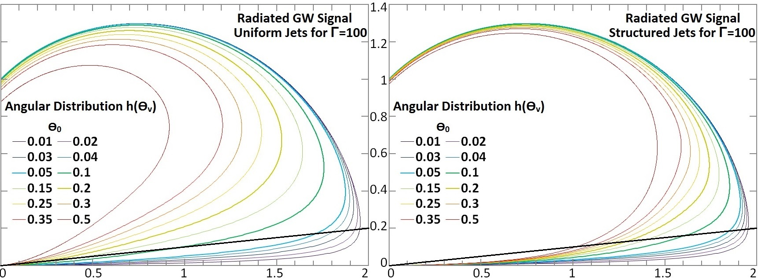
Wide Jets
Uniform jets – GW peak just-outside the jet.
Structured jets – GW peak outside the core, but within the jet.

Slide 6
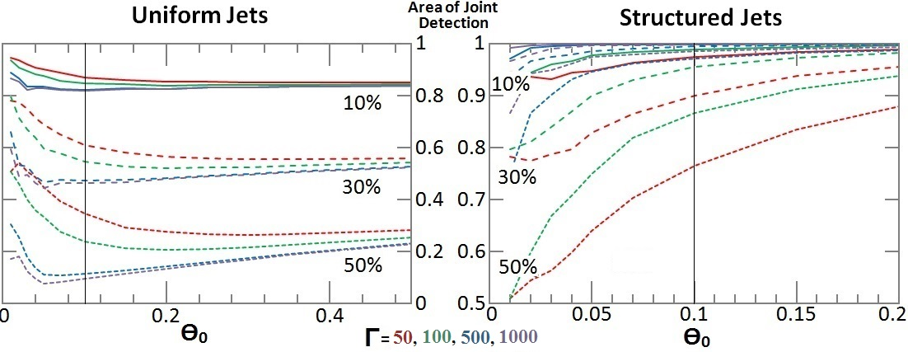
Joint Detection GW & EM
The GW amplitude decreases only slightly away from its peak
A relatively large amplitude can be seen within the EM cone

Slide 7
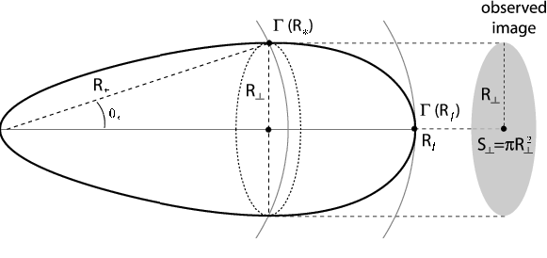
Waveforms – non-instantaneous
Prolonged Acceleration (“Fireball Model”)
  (we are only interested in the acceleration phase, not entire GRB duration)
Anti-Beaming depends on Γ, therefore on r and on t
Signal formed by “Equal
Arrival Time Surfaces”
(same retarded time)
Spectrum: sinc, up to frequency ~Γ/T_{f} 1
Granot & Ramirez-Ruiz 2010

Slide 8
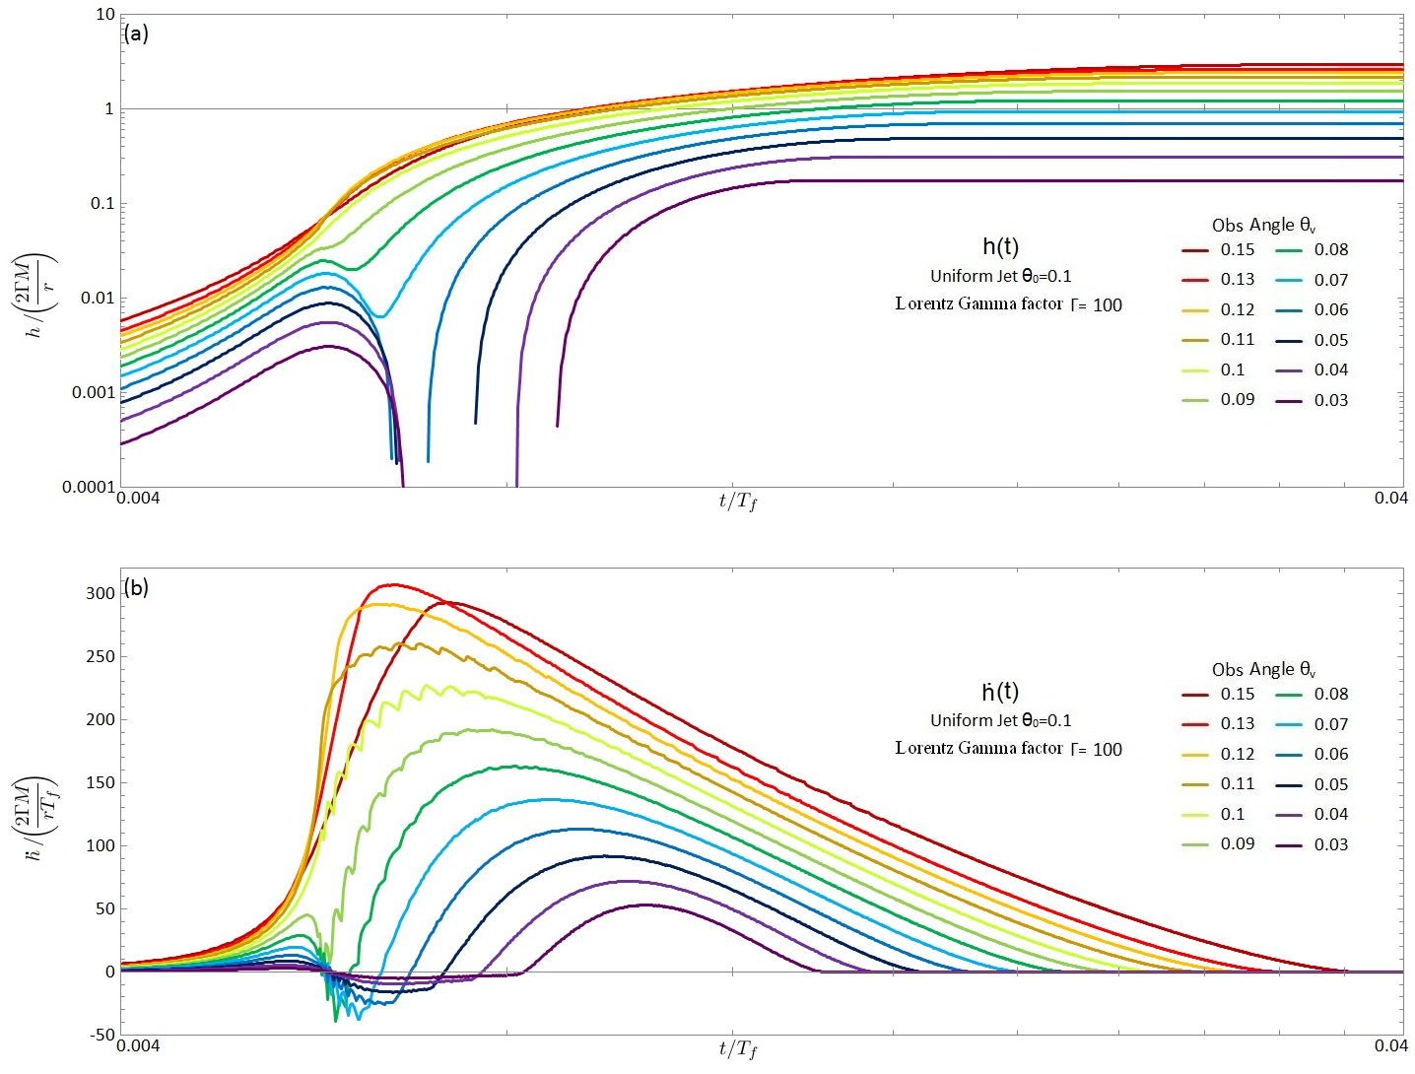
Shallow increase until ~2T_{f}
Sharp rise
t_{rise}~½Γ⁻¹T_{f}
Wiggles
before peak,
within jet cone
a

Slide 9
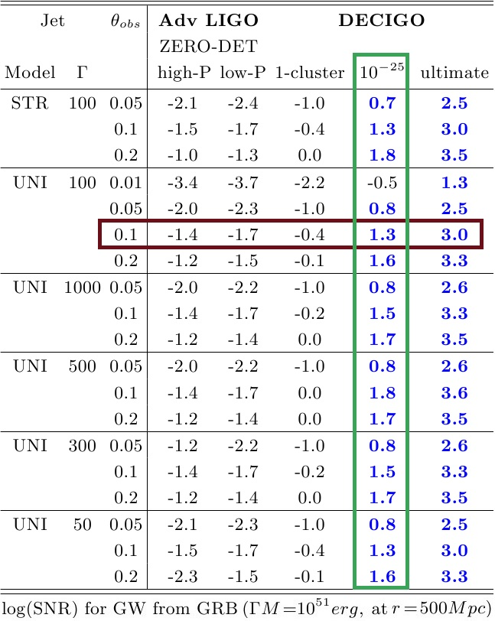
Detection – SNR & Rates
Typical sources
  Long GRB rate ~1yr⁻¹Gpc⁻³, ΓM=10⁵¹erg
  Short GRB rate ~8yr⁻¹Gpc⁻³, E~10⁵⁰erg
Fiducial: long GRB at r=0.5Gpc
Advanced LIGO: too faint
Ultimate DECIGO: entire universe
DECIGO band with ~10⁻²⁵/√Hz:
  Monthly detection long GRB (~2Gpc)
  Short GRB every decade (~200Mpc)
  Also ~50x more orphan afterglows
  Jet structure and parameters introduce
  a factor of ~¼-4 in SNR/range
    => ~10⁻²-10² in rates

Slide 10
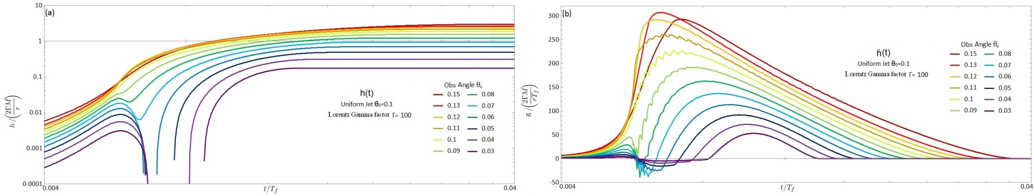
Conclusions
Powerful and frequent Astrophysical phenomena
Jets are sources in DECIGO band
Waveforms offer clues about the jet properties
  Angular structure (uniform/structured/other)
  Acceleration models (thermal/poynting/other)
And about the Engines?

Slide 11
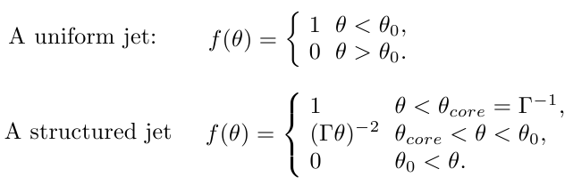
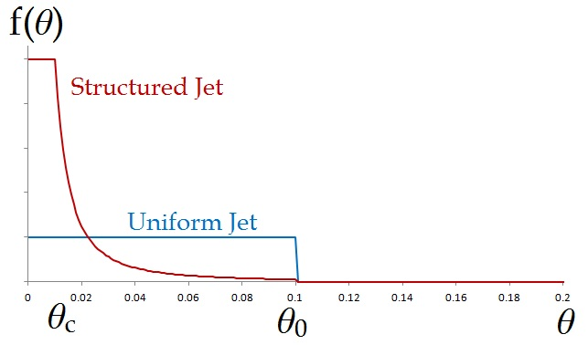
Appendix A
Jet structures:
Rossi, Lazzati & Rees 2002

Slide 12
Appendix B
Waveform results:
  Scaling: amplitude h~ ΓM/r, time ~ T_{f}.
  Sharp rise in the signal over a timescale t_{rise}~½Γ⁻¹T_{f}
    Time contraction of Γ⁻¹ due to the quadrupolar anti-beaming, rather than Γ⁻² for EM
  Long slow increase until ~2T_{f}
  Wiggles preceding the peak at observation angles within the jet cone, due to polarization
    A difference in the expected signals between uniform and structured jets

