Slide 1
Testing QED with Precision Spectroscopy of the Helium Atom
Yu Sun
孙羽
University of Science and Technology of China,
Hefei, Anhui, P. R. China

Slide 2
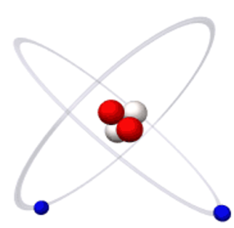
Introduction : Simple Atom, Fundamental Physics
⁴He
Fine Structure
³He
Hyperfine Structure
Lamb Shift
QED Theory Test
High Precision-
Quantum Calculation
Electric Dipole
Forbidden Transition
³He/⁴He IS
⁶He/⁸He IS
Nuclear Charge Radius
[Shui-ming Hu, Zheng-Tian Lu, Zong-Chao Yan,
Front. Phys. China, 2009,4(2), 165]
Notes:
Simple structure , Helium atoms play, It is also among, with the calculation…., It can , main task, around the main task, Our project are proposed , three professor, test ,mearue

Slide 3
He-4 (1s2p) 2³P Fine Structure Interval Splitting
Splitting Result before Our Work
He-4 2³P_{J}
Pachucki’10
Pachucki’10
³P₀
Theory
Theory
V₀₂ 32 GHz
Experiment
Experiment
³P₁
³P₂
V₁₂ 2.3GHz
York’01
York’09
Microwave Spectroscopy
Harvard’05
Harvard’05
1083nm
Saturation Spectroscopy
North Texas’10
North Texas’00
1s2s ³S₁
Laser Spectroscopy
-8
-4
0
6
9
V₀₂ – 31,908,134(kHz)
V₁₂ – 2,291,170(kHz)
Notes:
We are most interesting, It has two intervals, 2.3,32, Through this picture, once in the history, under the testing of …. The theory physics re-examine , right now the theoretic ,,but the result between different experiments ..

Slide 4
Experimental Configuration
2D-MOT
pump
probe
Transverse Cooling
Stern-Gerlach
LN2
TC-2
2¹S₀+UV
$$\frac{∂B}{∂z}$$
m=-1
m=+1
RF
excitation
State preparation
Spec. measurement
Laser Cooling
State-selection Detection
1s2s ³S₁
2³P₂
2³P₁
2³P_{1,2}
1s2s ¹S₀
2³P₀
2³S_{1(1,-1)}
2³S₁₍₀₎
2³P₁
2³S₁
2³S₁₍₀₎
2³S_{1(1,-1)}
e⁻($\sim$20eV)
2³P₂
1s1s ¹S₀
$σ$+
$$π$$
2³S₁+2¹S₀+UV
2³S₁
X 50 times
m=-1
m=0
m=+1
Notes:
3m long, 50 times TC, deflects by 0.1 degree
Polished stainless steel plate, ejects electrons, detected by a Channeltron.

Slide 5
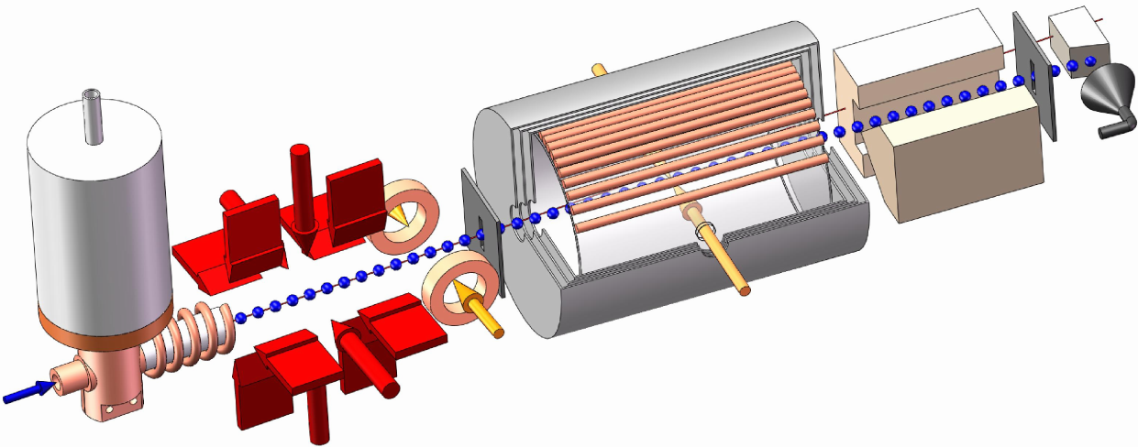
Experimental Configuration
Laser cooling based atomic beam system
3-meter long beam line
well shielded space
Stern-Gerlach
Magnet
Pre-Cooling
Helmholtz Coil
Cosine Coil
Channeltron
Detector
Magnetic shield
Atomic source
Laser Cooling Scheme
Notes:
用这套原子束流系统我们可以测量23P1-2，以及23P0-2的能级间隔

Slide 6
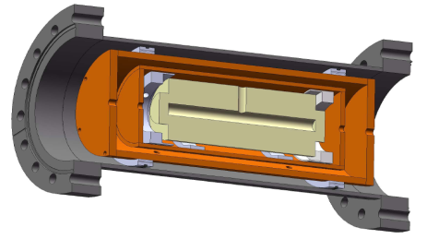
Optical Setup
Temperature controlled ULE cavity
2³P₁
Metastable Helium discharge cell
He*
Lock to 2³S₁-2³P₂ Transition
2³S₁
PDH locking scheme
680MHz
Beat Signal
2³P₂
Pump Laser
ECDL Master Laser
Cooling Laser
Phase lock module
2³S₁
Fiber EOM

Slide 7
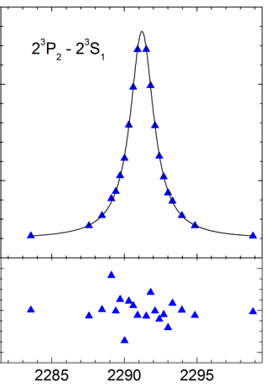
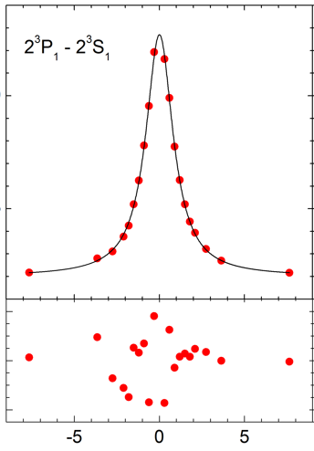
Fiber-EOM sideband scan
Carrier, locked
-1 sideband
+1 sideband
RF frequency
2³P₁
2.291 GHz
Carrier
2³P₂
Probe laser
2³S₁
1083nm
m=-2
m=-1
m=0
m=+1
m=+2
Notes:
首先我们测量了23P1-23P2能级的结果，为了能够扫描光谱信号。。

Slide 8
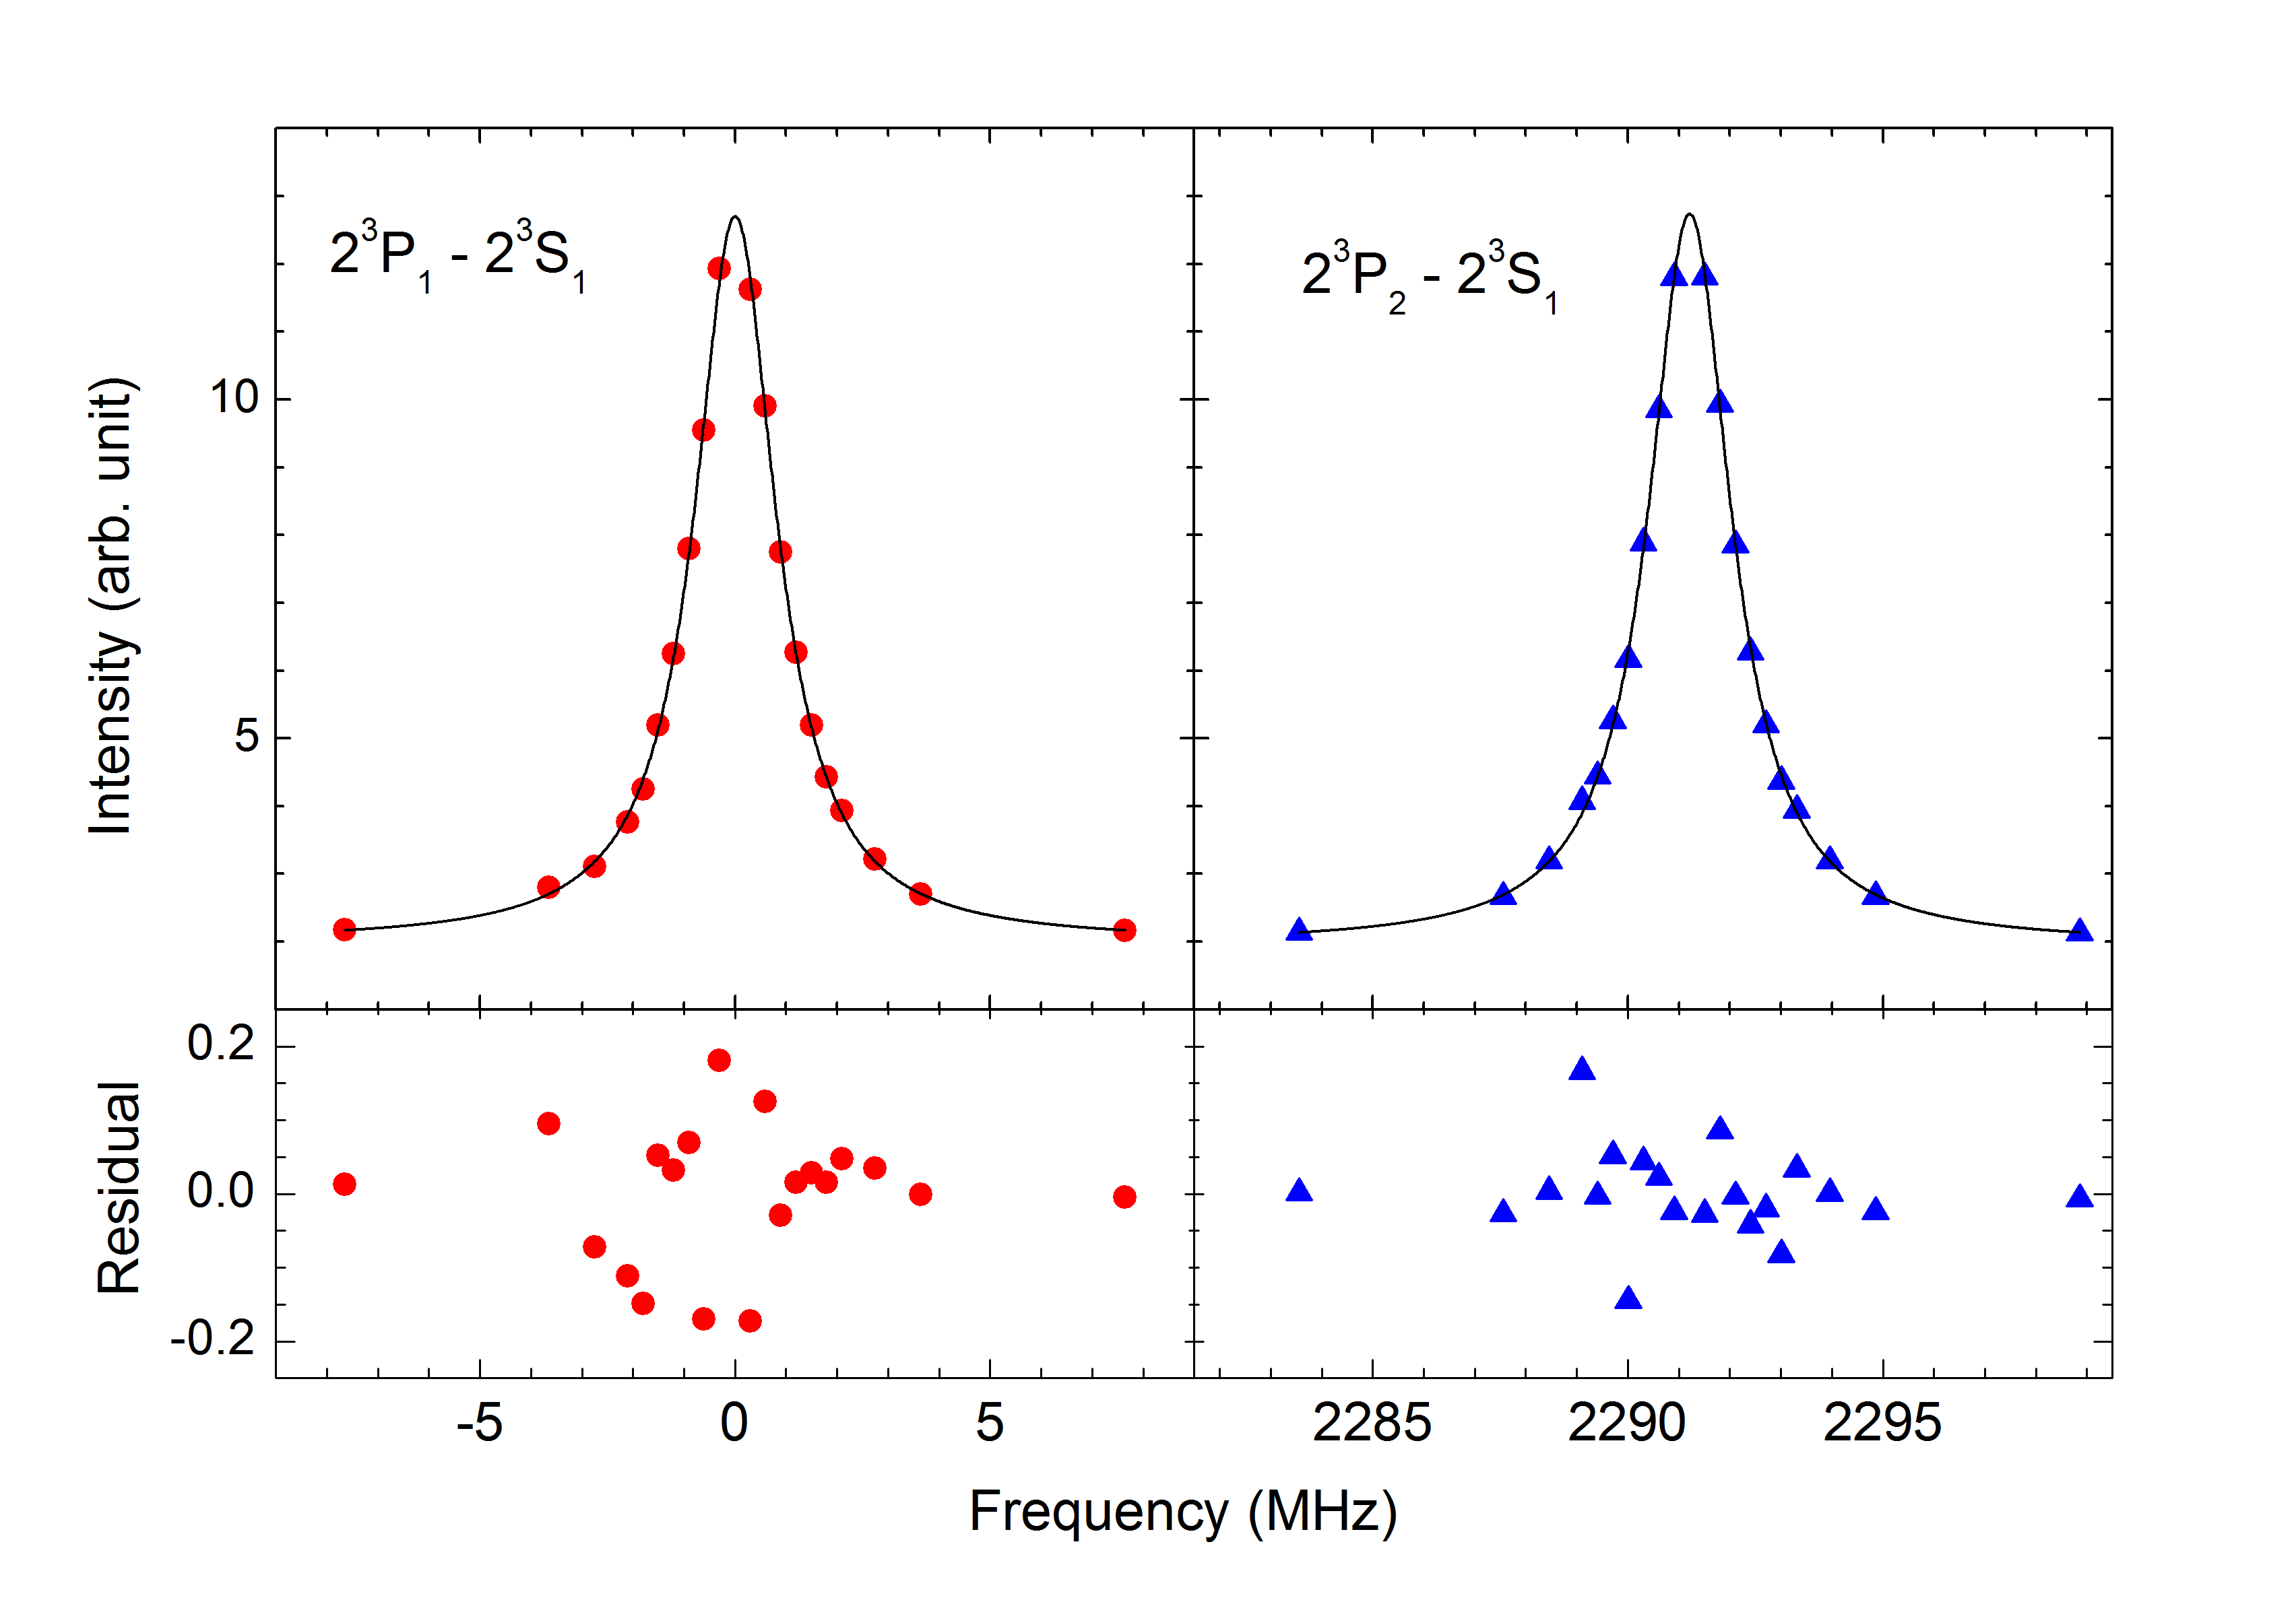
Single scan, ~2 min. Statistical uncertainty reduced to 170Hz by 15419 scans
$$∆f=\left|{f_{1}−f}_{2}\right|$$
f₁
f₂

Slide 9
Uncertainty budget (in kHz)
2³P₁-2³P₂ fine structure interval result
Source | ν (kHz) | Δν (1σ)
Statistical | 2 291 176.48 | 0.17
Zeeman Effect | —— | 0.09
Laser power | —— | 0.10
Laser polarization | —— | 0.08
1st-Order Doppler | —— | 0.11
Others | —— | 0.19
Quantum interference | + 1.21 | 0.16
Total | 2 291 177.69 | 0.36
G.–P. Feng, X. Zheng, Y. R. Sun*, S.–M. Hu,
Phys. Rev. A Rapid Communications 91, 030502(2015)

Slide 10
Quantum Interference Effect
$Γ_{0}$ ~ 1.6 MHz
Interference from distant neighboring resonances
2³P₁
2.29 GHz
$$\frac{interval}{Γ_{0}}=\frac{2 291 MHz}{1.6 MHz}≈1400$$
2³P₂
$$shift≈\frac{1.6 MHz}{1400}≈1.1 kHz$$
Rule of thumb
estimate
276.7 THz
(1083nm)
A calculated correction of 1.21(16)kHz for our 2³P₁-2³P₂ measurement.
2³S₁
M. Horbatsch, E. A. Hessels, Phys. Rev. A 82, 052519 (2010)
A. Marsman, M. Horbatsch, E. A. Hessels, Phys. Rev. A 91, 062506 (2015)
Notes:
Quantum Interference Shift is inversely proportional to the frequency difference between the energy levels.
When the laser is nearly resonant with the |1>-|2> transition, there are shifts due to interference with the |1>-|3> transition.

Slide 11
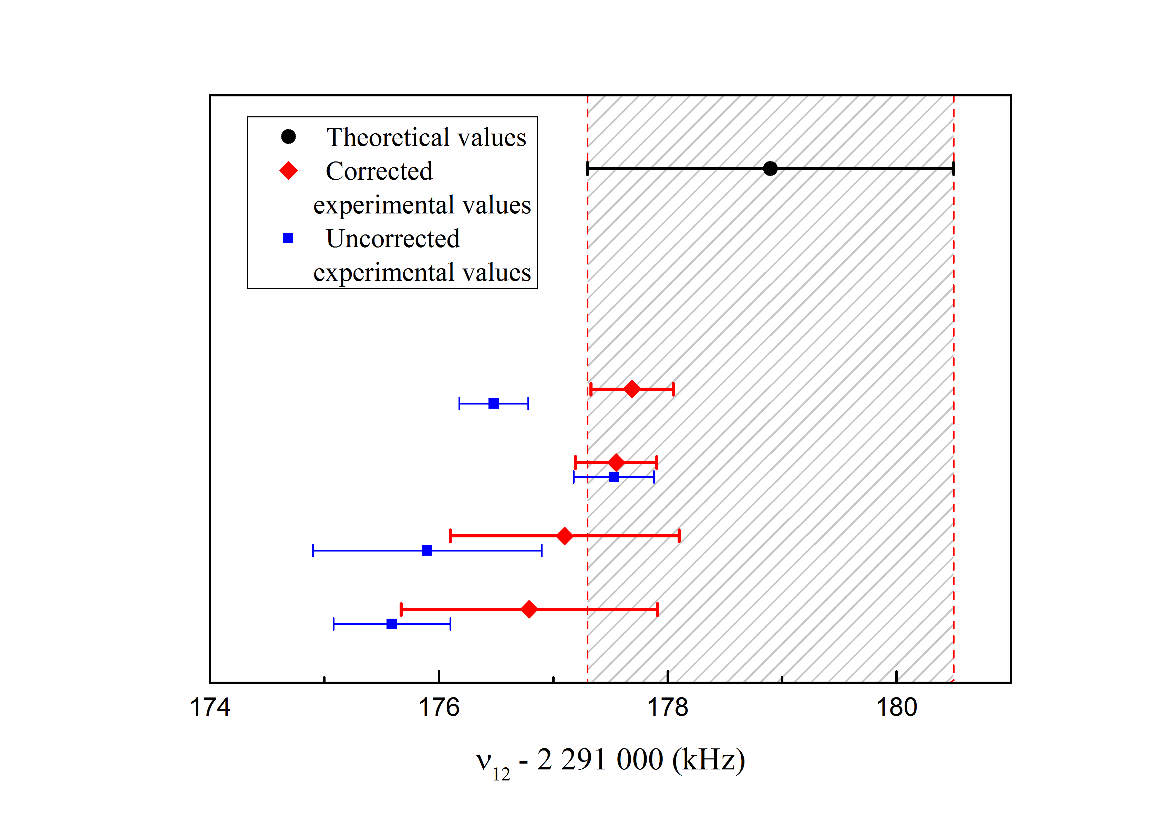
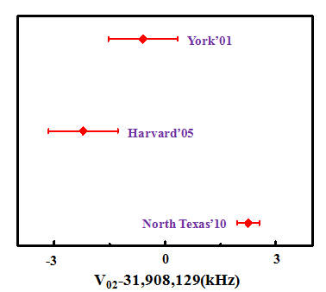
He-4 (1s2p) 2³P₁-2³P₂ Fine Structure Interval Splitting
2³P₀-2³P₂
2³P₁-2³P₂
He-4 2³P_{J}
³P₀
Pachucki’10
V₀₂ 32 GHz
USTC’15
³P₁
York’09
V₁₂ 2.3GHz
North Texas’00
³P₂
Harvard’05

Slide 12
He-4 (1s2p) 2³P₀-2³P₂ Measurement
The same atomic beam system
Probe laser polarization from 𝜋 to 𝜎
B field direction
New laser locking system
2³P₀
32 GHz
2³P₂
Probe Laser
𝜎-
2³S₁
1083nm
m=-2
m=-1
m=0
m=+1
m=+2
Notes:
我们目前正用这套装置测量23P0-23P2能级间隔

Slide 13
Old Setup
Helium Gas Discharge Cell
RF driven gas discharge
He*
For laser cooling Frequency lock
Need regular maintenance
Lack long term stabilization
Reduce SNR
Very Simple
Easy to build up
2³P₂
2³S₁

Slide 14
Old Setup
Fiber EOM Sideband Scanning
Sideband Power Variation
Reduce the SNR
𝛽=𝜋V/V_{1/2}

Slide 15
New Optical Setup
PDH locking scheme
Fiber Master Laser
Fiber EOM
+1st
-1st
15.6GHz
Temperature controlled ULE cavity
Phase lock module
15GHz
Beat Signal
÷8
2³P₂
Phase lock module
Phase lock module
Cooling Laser
ECDL Probe Laser I
ECDL Probe Laser II
2³S₁
Phase lock module
2.3GHz
Beat Signal
Frequency Accuracy
Power Stabilization
2³P₁
Shutter I
Shutter II
Pump Laser
Fiber coupler
Power Noise Eater
2³S₁

Slide 16
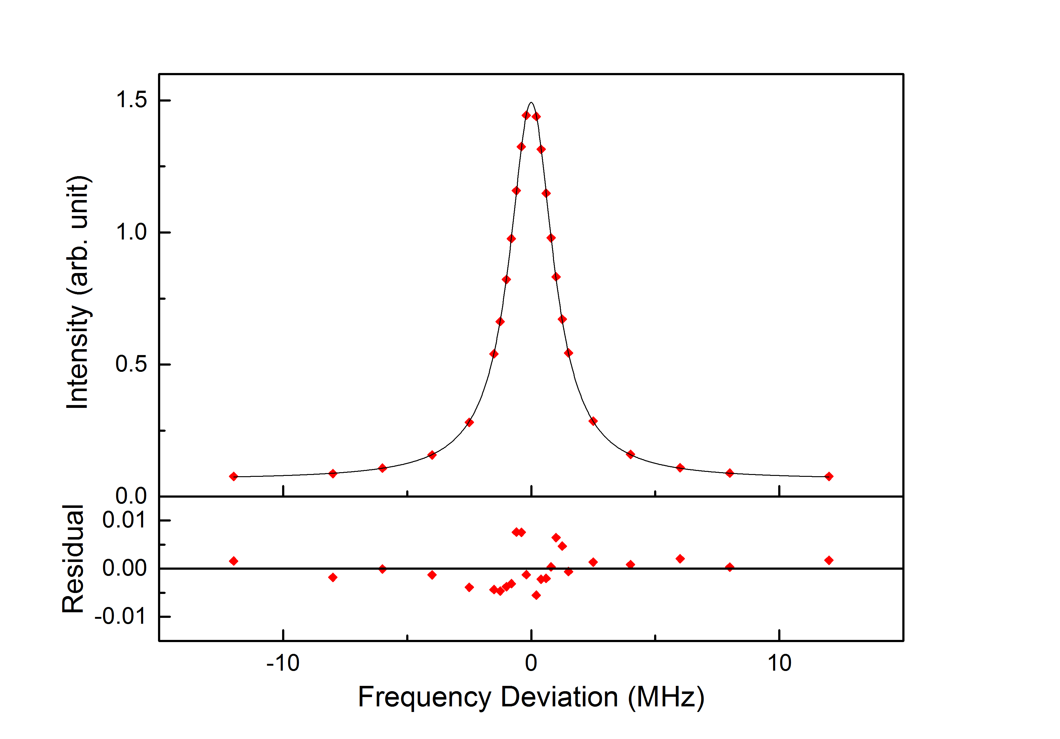
System Improvement
Increase the SNR by a factor of 3
Statistical error < 100Hz
Single scan, ~1 min

Slide 17
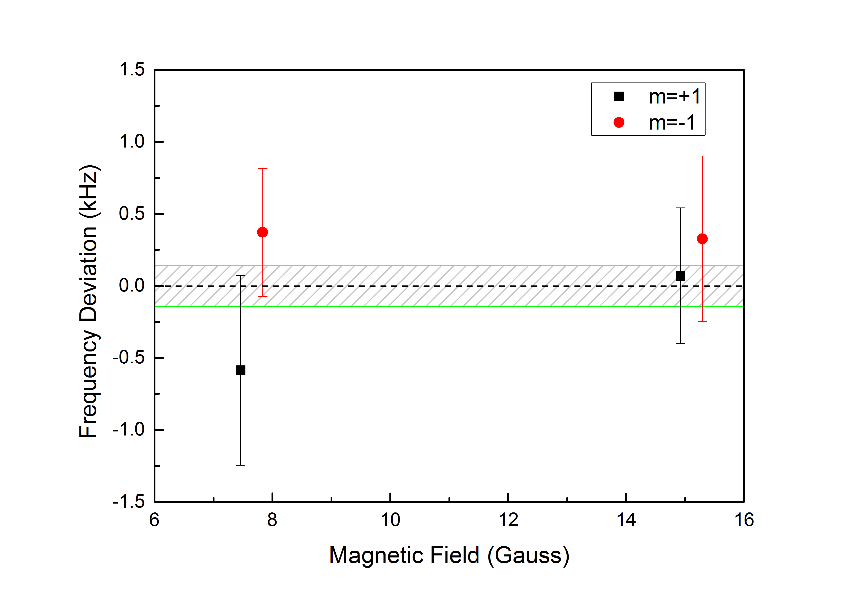
Systematic Check -- Probe Lasers
No systematic deviation between the two lasers
2³P₂
2³S₁
ECDL Probe Laser I
ECDL Probe Laser II

Slide 18
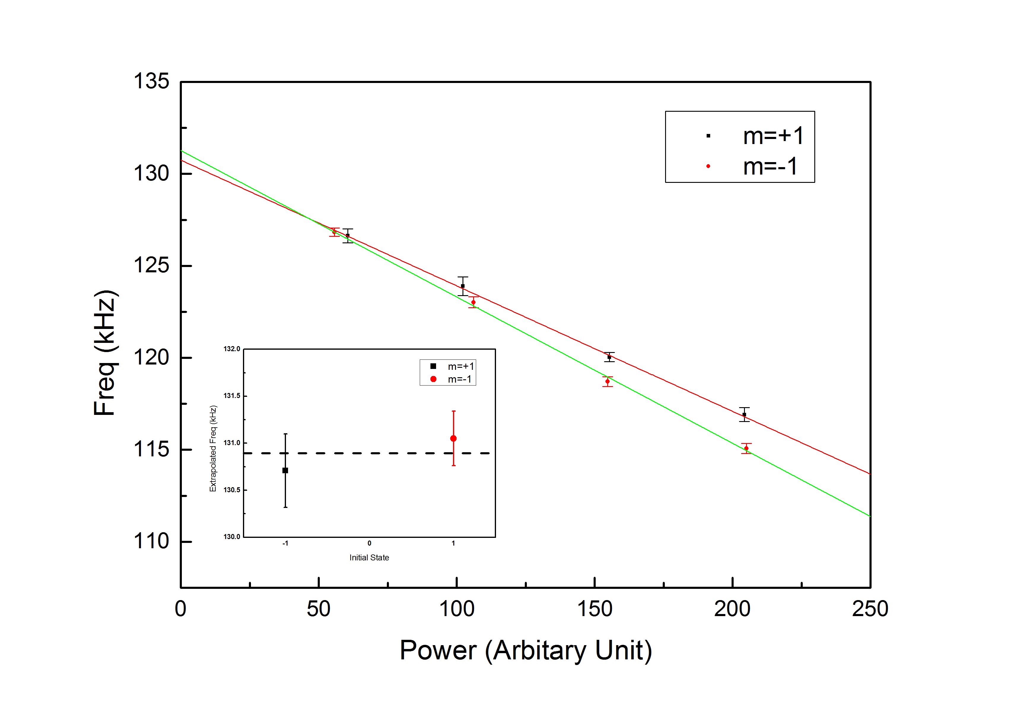
Systematic Check -- Laser Power
2³P₀
32 GHz
2³P₂
Probe Laser
𝜎+
𝜎-
2³S₁
1083nm
m=-2
m=-1
m=0
m=+1
m=+2

Slide 19
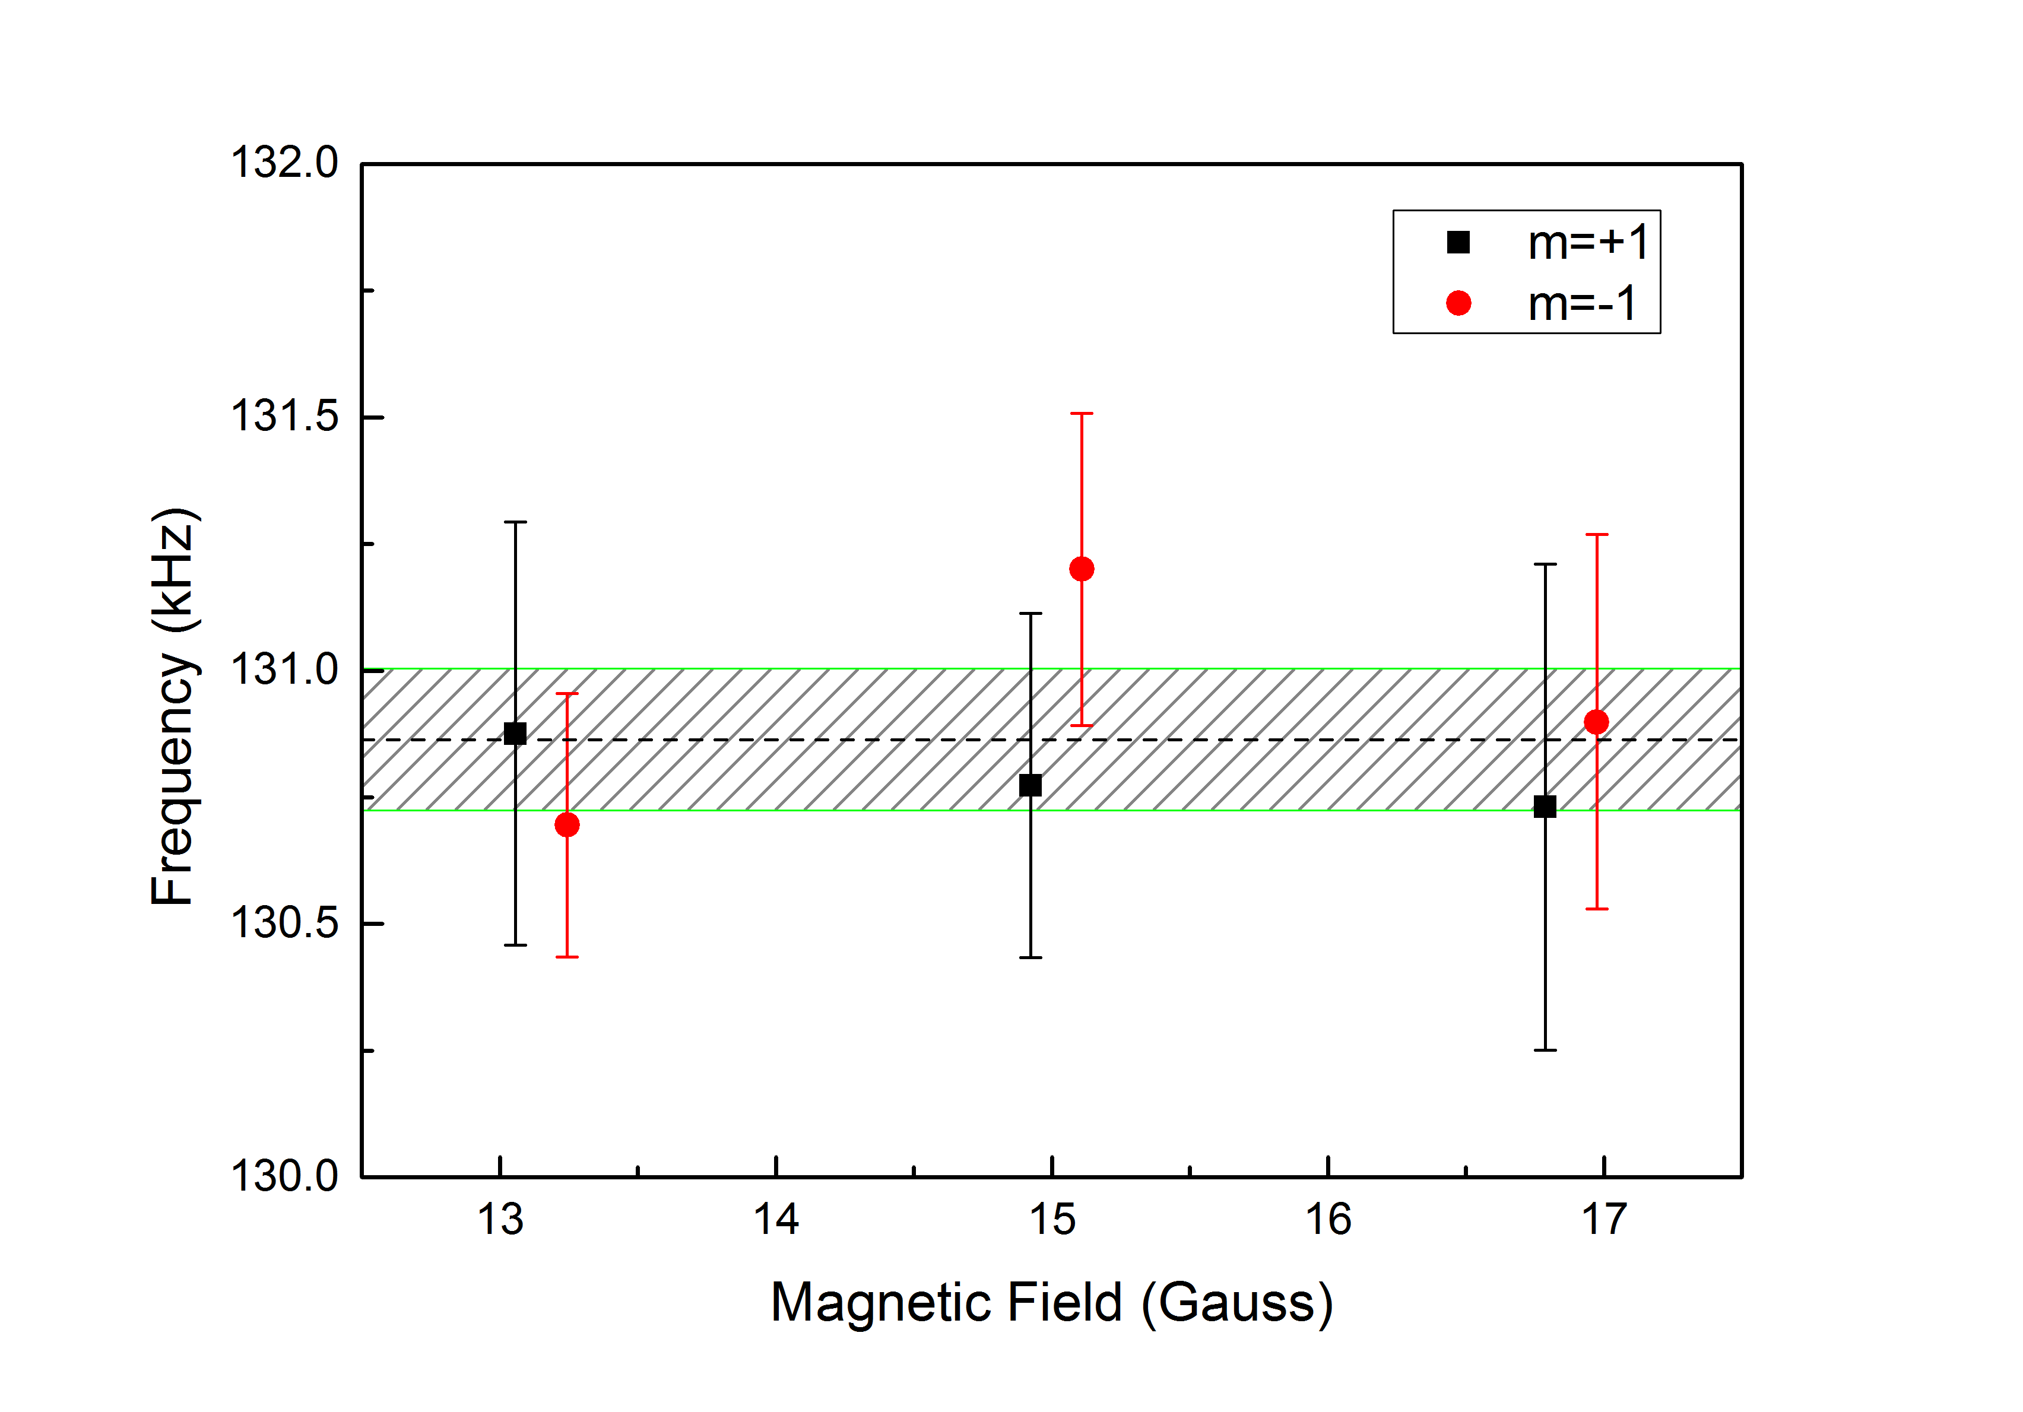
Systematic Check -- Magnetic Field
Second order Zeeman shift corrected

Slide 20
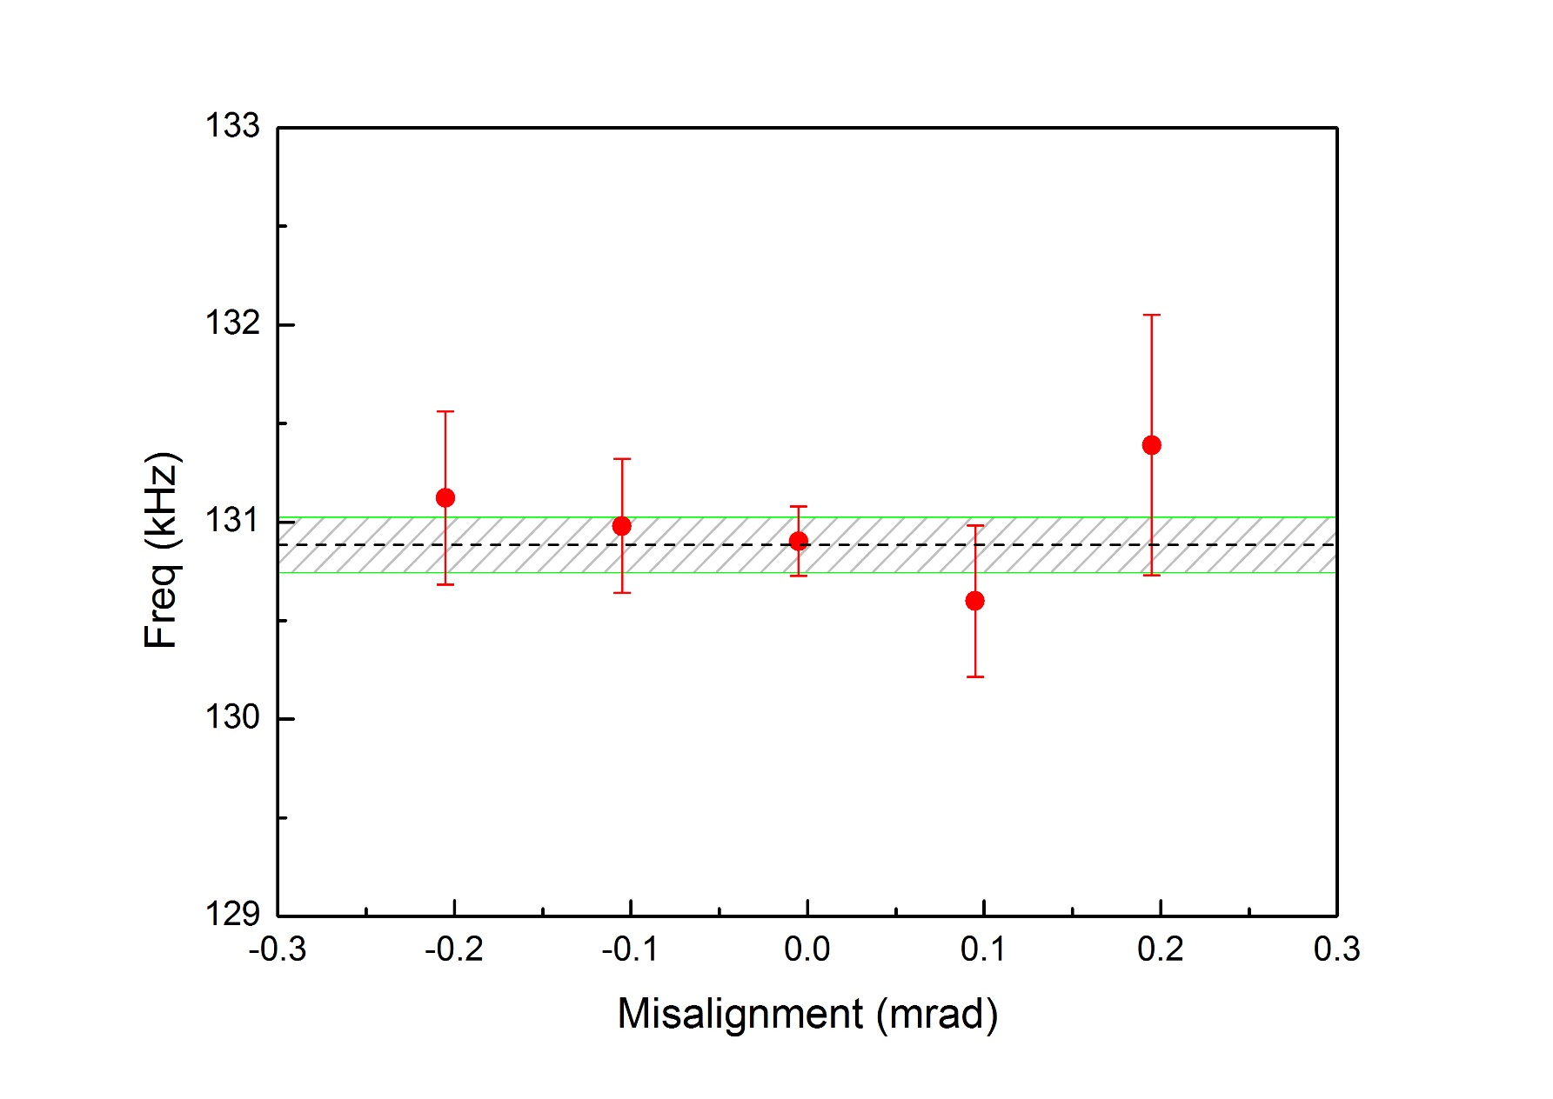
Systematic Check -- Doppler Effect
Probe Laser
Atomic Beam
Normally we worked on the misalignment well below 20urad
No obviously systematic effect when the misalignment within 200urad

Slide 21
Uncertainty Budget (in kHz) Estimation(Preliminary)
2³P₀-2³P₂ fine structure interval result
Source | ν (kHz) | Δν (1σ)
Statistical | 31,908,130.88 | <0.1
Zeeman Effect | —— | <0.05
Laser power | —— | <0.10
1st-Order Doppler | —— | <0.1
Others | —— | <0.1
Quantum interference | < 0.08
Total | 31,908,130.88 | <0.2

Slide 22
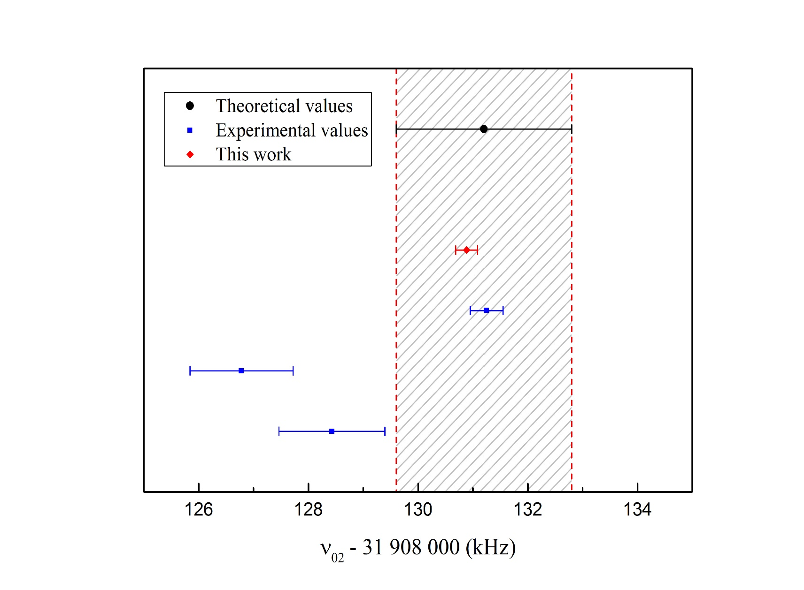
2³P₀-2³P₂ Result Comparison(Preliminary)
Pachucki
USTC
North Texas’10
Harvard’05
York’01

Slide 23
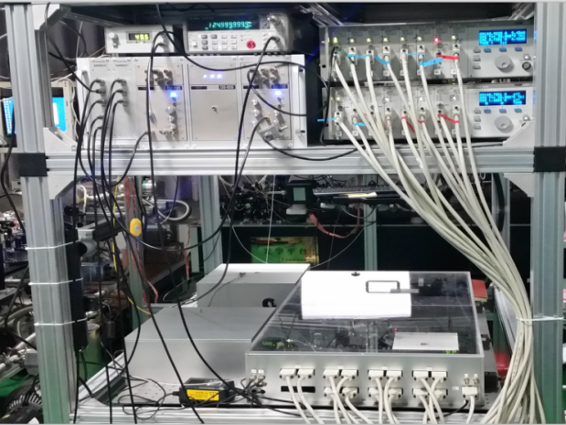
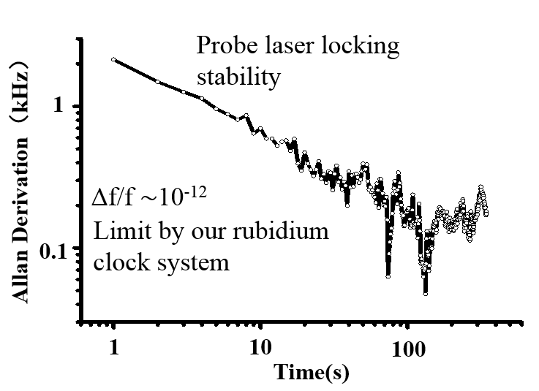
Outlook
For Absolute Frequency measurement
Zhan-Jun Fang
Fei Meng
NIM
Notes:
We also have prepared the frequency comb system, it can be used to discriminate our probe laser center frequency stability or to determine the absolute frequency of the transition.

Slide 24
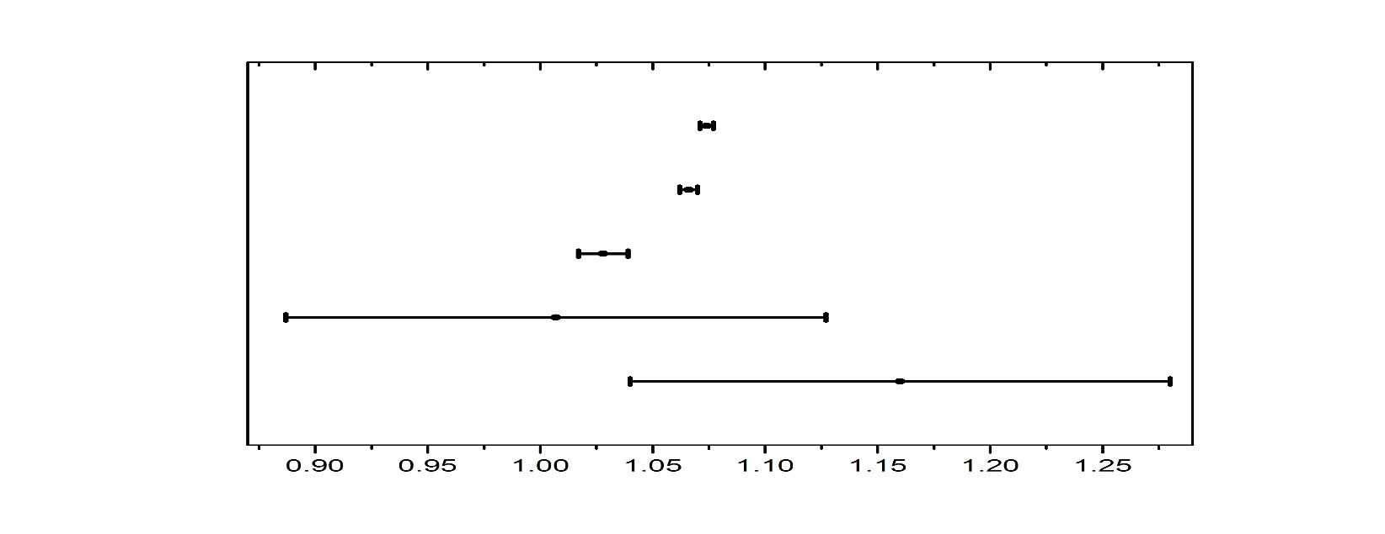
Outlook
Isotopic shift (³He&⁴He) $→$The nuclear charge radius discrepancy
2³P-2³S saturated absorption
2³P-2³S laser spectroscopy
Atom trap 2¹S-2³S
Electron-scattering
nuclear theory
δr²[³He-⁴He](fm²)
³He/⁴He 2¹S-2³S -R.van Rooij et al, Science 333,196(2011)
³He/⁴He 2³P-2³S–P.Cancio Pastor et al, PRL 108,143001(2012)
E(³He,2³P₀^{1/2}-2³S₁^{3/2})-E(⁴He,2³P₂-2³S₁）-D.Shiner, PRL 74,3553(1995)
“The results forδR² derived from the 2³P-2³S and 2¹S-2³S transitions are shown to disagree with each other by about four standard deviations. The reason of this disagreement is presently not known”
- K. Pachuchi and V. A. Yerokhin J. Phys. Chem. Ref. Data(2015)
Notes:
Another interesting thing we can do is to test the isotopic shift of the He-3 and He-4 atom. The current puzzle that 23P-23S and 21s-23s transitions disagree with each other by four standard deviations are still unknown. Take advantage of our beam system and the frequency comb system, we shall improve the current measurement to a precise of 1 kHz. So hopefully we can solve this puzzle.

Slide 25
Acknowledgement
Thank You !!!
USTC
Shui-ming Hu
Zheng-Tian Lu
Wei Jiang
NIM
Zhan-Jun Fang
Fei Meng
UNB (CA)
Zong-Chao Yan
Funding:

