Slide 1
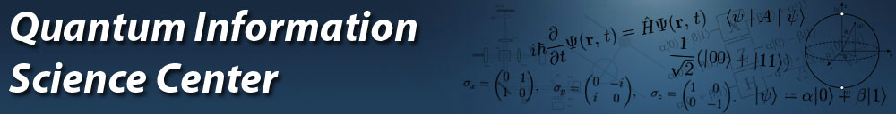
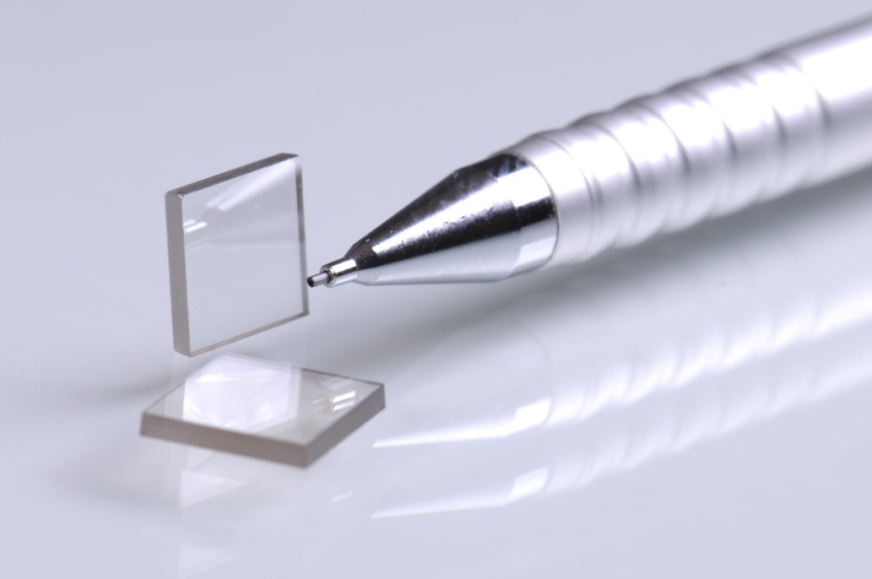
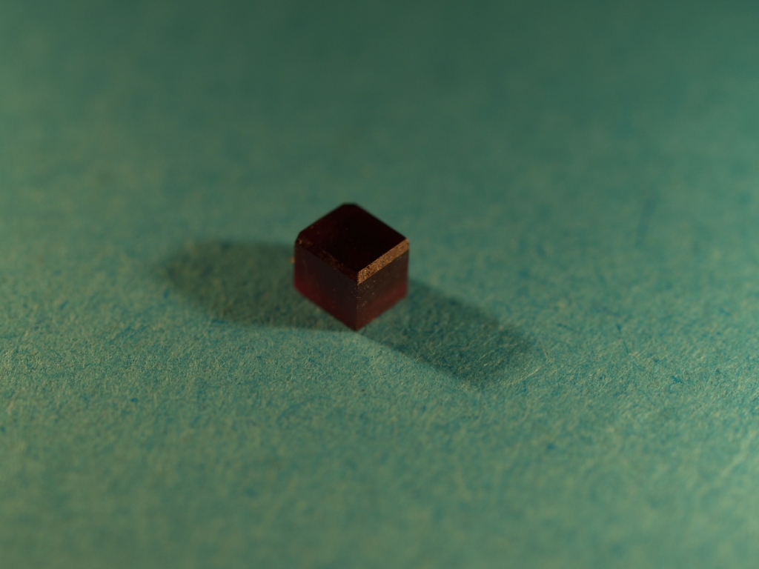
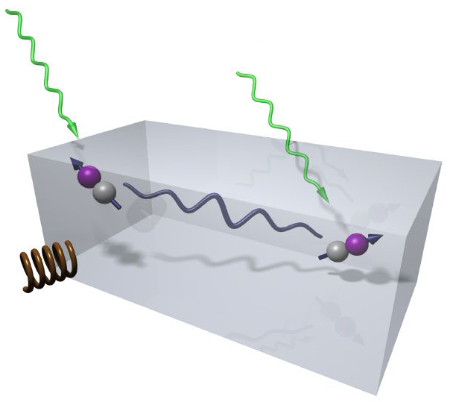
Frequency locking and error correction based sensing schemes
Alex Retzker
HUJI
PSAS2016
23.05.2016
Tuvia Gefen, Nati aharon, Itsik Cohen, Daniel Cohen,
Thomas Unden, Prya balasubramanian, Daniel Louzon, Martin Plenio, J.M Cai ,Mikhail Lukin, L. Cohen, Y. Pilnyak, D. Istrati, H. S. Eisenberg Christof Wunderlich, Ingo Baumgart and Fedor Jelezko.

Slide 2
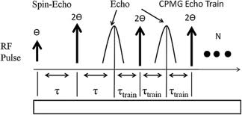
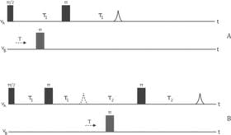
Quantum Sensing
Quantum sensing scales as:
Thus dynamical decoupling is used to increase the coherence time
Challenge: increasing the coherence time while reading the signal
Notes:
In this slide I will describe the basic idea of error correction

Slide 3
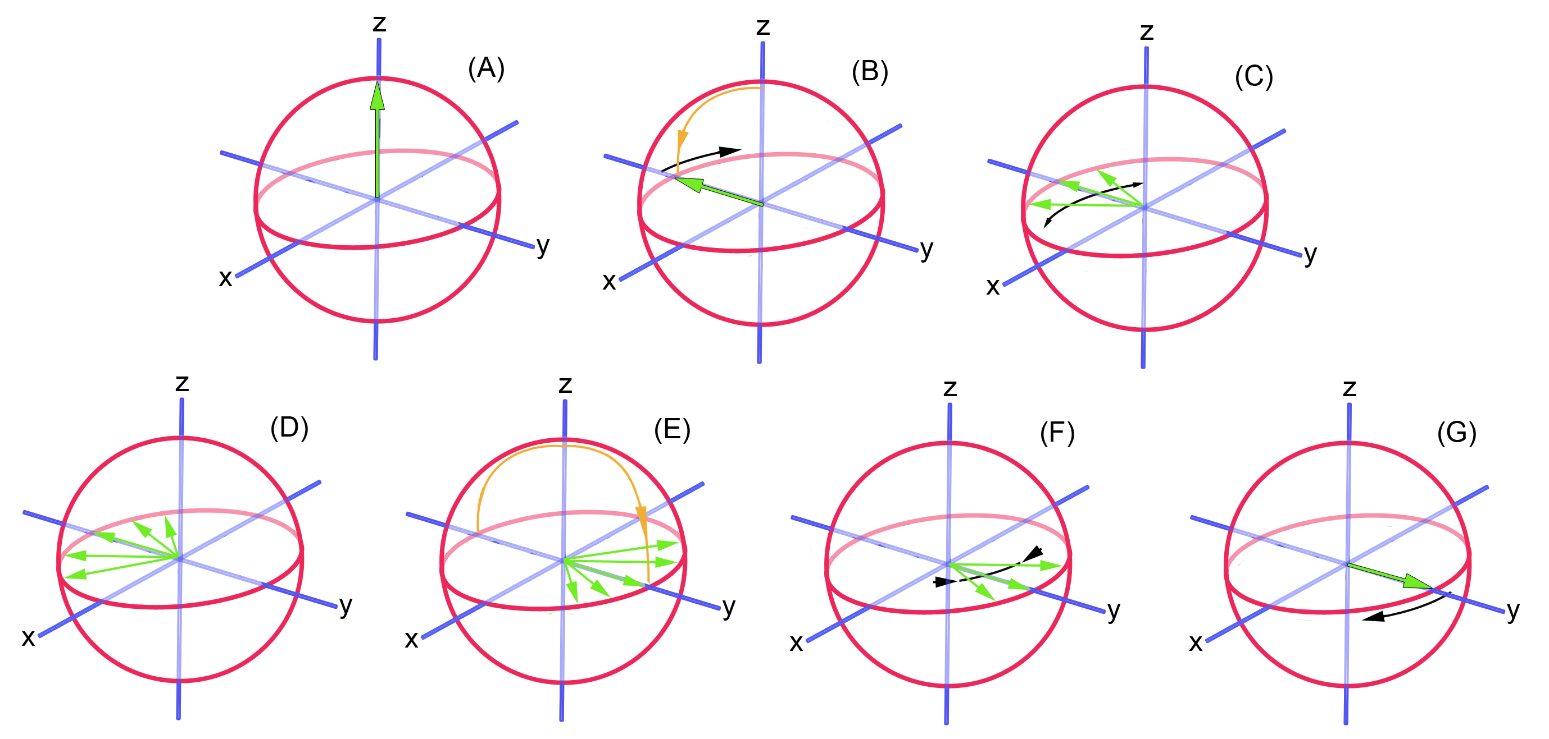
Hahn Echo:

Slide 4
Carr Purcell – CP:
A sequence of echos, i.e., of π pulses focuses the polarization for a long time
z
y
x
Notes:
In order to deal with time dependant noise the sequence has to be more and more frequent depends on the power spectrum of the noise. Thus the sequence will noise with power spectrum which is lower then the frequency of the decoupling pulses. However this pulse is not resilient to noise in the pulses.

Slide 5
Carr Purcell – CP:
A sequence of echos, i.e., of π pulses focuses the polarization for a long time
z
z
y
y
2 δΦ
π+δΦ
x
x
Notes:
In order to deal with time dependant noise the sequence has to be more and more frequent depends on the power spectrum of the noise. Thus the sequence will noise with power spectrum which is lower then the frequency of the decoupling pulses. However this pulse is not resilient to noise in the pulses.

Slide 6
Improved CPMG:
z
z
y
y
π+δΦ
π+δΦ
x
x
Notes:
Another option is to rotate around y and that’s what lied around the composite pulses idea, i.e., to do pulses of y and then –y instead of y and then y

Slide 7
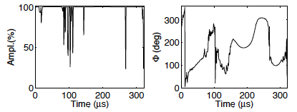
Coherent control
Timoney et, al., 2007
PSAS2016 I 28.04.2016 I Slide: 7
Notes:
In this slide I will describe the basic idea of error corrDiamond and Spins Schoolon

Slide 8

Working with ensembles
A strong pulse in needed to work on all systems identically
PSAS2016 I 24.05.2016I Folie: 8

Slide 9
Power issues
The ratio between continuous and pulsed:
PSAS2016 I 24.05.2016I Folie: 9

Slide 10
Dynamical Decoupling: Spin locking
Flipping(T1) Rate:
Dephasing(T2) Rate:
Dephasing(T2) Rate:
PSAS2016 I 24.05.2016 I Folie: 10
Notes:
The original magnetic noise is in all directions but the Zeeman splitting opens a gap and cancels the noise in the two other directions.
The microwave amplitude noise is of the order of 1%, which means if we have to drive the system at a few 10’s of kHz we will get noise at a fraction of a kHz and thus around 10’s of msof T2.

Slide 11
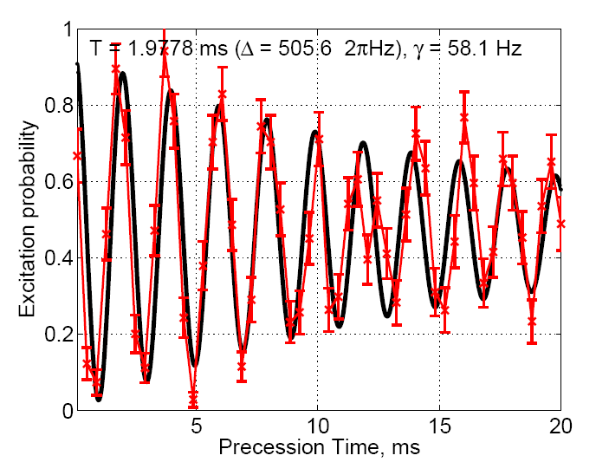
Cohernce time of dressed states
Coherence time τ ≈ 20 ms
Data from Wunderlich group
PSAS2016 I 24.05.2016I Folie: 11

Slide 12
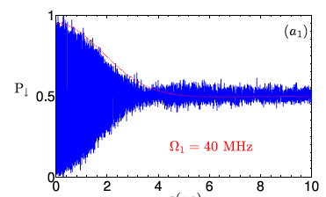
Single drive
Cai et al., New J. Phys. 14 113023 (2012)
PSAS2016 2015 I 24.05.2016 I Folie: 12
Notes:
In this slide I will describe the basic idea of error corrPSAS2016on

Slide 13
Carr Purcell – CP:
A sequence of echos, i.e., of π pulses focuses the polarization for a long time
z
z
y
y
2 δΦ
π+δΦ
x
x
Notes:
In order to deal with time dependant noise the sequence has to be more and more frequent depends on the power spectrum of the noise. Thus the sequence will noise with power spectrum which is lower then the frequency of the decoupling pulses. However this pulse is not resilient to noise in the pulses.

Slide 14
Stable Qubit
Sequential continuous dynamical decoupling
Plus non-rotating drive terms
Cai et al., New J. Phys. 14 113023 (2012)
PSAS2016 2015 I 24.05.2016 I Folie: 14
Notes:
In this slide I will describe the basic idea of error corrPSAS2016on

Slide 15
Coherent control
Timoney et, al., 2007
PSAS2016 I 28.04.2016 I Slide: 15
Notes:
In this slide I will describe the basic idea of error corrDiamond and Spins Schoolon

Slide 16
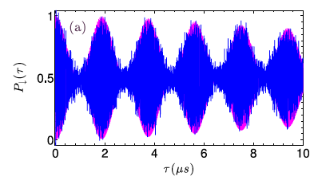
Single drive
Cai et al., New J. Phys. 14 113023 (2012)
PSAS2016 2015 I 24.05.2016 I Folie: 16
Notes:
O1=40MHz and O2= 20KHz

Slide 17
But if we have more levels maybe we could so something better
PSAS2016 2015 I 24.05.2016 I Folie: 17
Notes:
The original magnetic noise is in all directions but the Zeeman spillitng opens a gap and canclels the noise in the two other directions

Slide 18
Dynamical Decoupling: multi level struture
Dephasing(T2) Rate:
Quantum Computing-> Sensing
N. Timoney, I. Baumgart, M. Johanning, A. F. Varon, Ch. Wunderlich, M. B. Plenio, A. R Nature 476, 185 (2011)

Slide 19
Robust magnetometry
Measured Sensitivity by Wunderlich:
signal
The signal is locked to the frequency and not to Rabi frequency
signal
I. Baumgart, J.M. Cai, M. B. Plenio, A. R, C. Wunderlich PRL (2016)
Notes:
Roee got 15pt/sqrt{Hz}

Slide 20
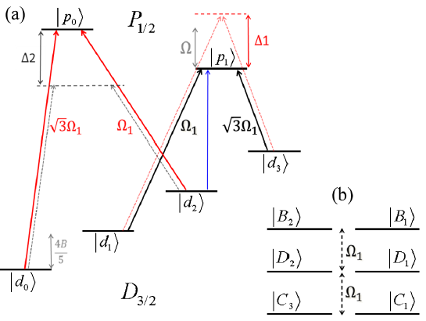
Generalisation to N levels
N. Aharon, M. Drewsen, and A.R, PRL 111, 230507 (2013)
Notes:
In this slide I will describe the basic idea of error corrPSAS2016on

Slide 21
For NVs
N. Aharon, I. Cohen, AR in preparation
Notes:
In this slide I will describe the basic idea of error correction

Slide 22
Dressed states
(a)
(b)
Robust qubit
N. Aharon, I. Cohen, AR in preparation
Notes:
In this slide I will describe the basic idea of error correction

Slide 23
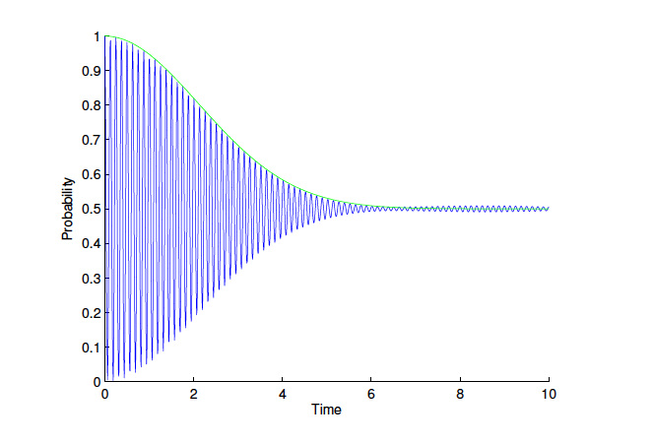
Pure dephasing
N. Aharon, I. Cohen, AR in preparation
Notes:
In this slide I will describe the basic idea of error correction

Slide 24
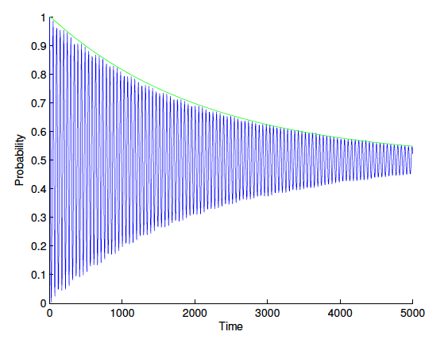
With drive of 100MHz
N. Aharon, I. Cohen, AR in preparation
Notes:
In this slide I will describe the basic idea of error correction

Slide 25
Good and bad levels – Error correction
Two ‘good’ levels
Two ‘sensing’ levels
G. Arrad, Y. Vinkler, D. Aharonov, A. R, PRL 112, 150801(2014)
PSAS2016 2015 I 24.05.2016 I Folie: 25
Notes:
The original magnetic noise is in all directions but the Zeeman spillitng opens a gap and canclels the noise in the two other directions

Slide 26
Good and bad levels
Weak coupling to noise
Weak coupling to signal
Weak coupling to noise
Strong coupling to signal
Strong coupling to noise
Strong coupling to signal
G. Arrad, Y. Vinkler, D. Aharonov, A. R, PRL 112, 150801(2014)
PSAS2016 2015 I 24.05.2016 I Folie: 26
Notes:
The original magnetic noise is in all directions but the Zeeman spillitng opens a gap and canclels the noise in the two other directions

Slide 27
General Idea of error correction for quantum computing
error1
error2
Code
Logical operation
Error N
G. Arrad, Y. Vinkler, D. Aharonov, A. R, PRL 112, 150801(2014)
Notes:
In this slide I will describe the basic idea of error correction

Slide 28
Error correction – majority vote
Regular majority vote code
Error1
Error3
Error2
Notes:
The proportionality coefficient is \sqrt{log2}

Slide 29
General Idea of error correction for quantum sensing
error1
error2
Code
However, the sensing signal is weak/slow and the logical operation is strong/fast
Sensing signal
Error N
Notes:
Here I will describe the basic idea of quantum sensing and the problem

Slide 30
Advantage – use of protected qubits
Code
Sensing qubit
Good qubits
Notes:
The main simplification of doing sensing over computing

Slide 31
Example: fighting dissipation
Using dynamical decoupling have to be faster than
Using error correction have to be faster than
Notes:
The proportionality coefficient is \sqrt{log2}

Slide 32
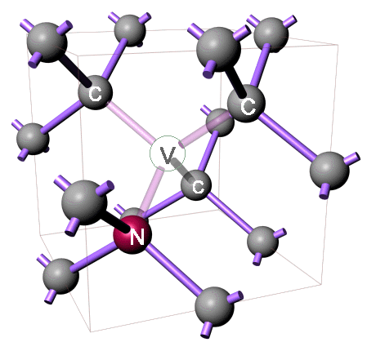
Example: fighting T1
Using dynamical decoupling have to be faster than
Using error correction have to be faster than
Notes:
The proportionality coefficient is \sqrt{log2}

Slide 33
Quantum error correction for sensing
The sensing signal is weak/slow and the logical operation is strong/fast
Instead of the nine/five qubit code a simpler code with good qubits can be designed
Robust qubits
Sensing qubit
PSAS2016 I 24.05.2016 I Folie: 33
Notes:
The original magnetic noise is in all directions but the Zeeman spillitng opens a gap and canclels the noise in the two other directions

Slide 34
Quantum error correction for bit flip error
Initial state:
Cnot-Gate:
Free evolution:
Laser:
Error:
Cnot-Gate:
T. Unden, ..A. R, F. Jelezko PRL (2016)

Slide 35
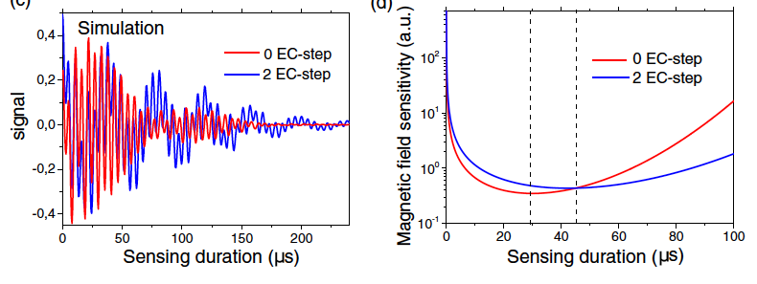
Electron and nuclear spin
T. Unden, ..A. R, F. Jelezko PRL (2016)
Notes:
In this slide I will describe the basic idea of error correction

Slide 36
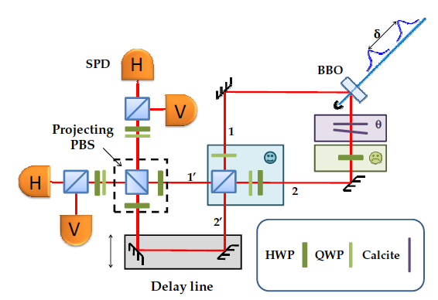
With drive of 100MHz
L. Cohen, Y. Pilnyak, D. Istrati, A. Retzker, H. S. Eisenberg Arxiv (2016)
Notes:
In this slide I will describe the basic idea of error correction

Slide 37
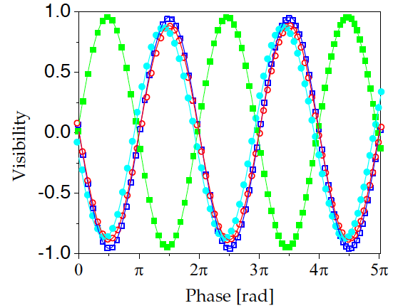
With drive of 100MHz
L. Cohen, Y. Pilnyak, D. Istrati, A. Retzker, H. S. Eisenberg Arxiv (2016)
Notes:
In this slide I will describe the basic idea of error correction

Slide 38
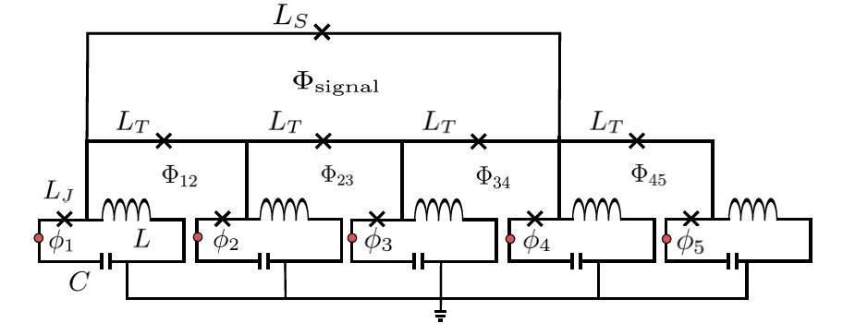
Back to Heisenberg scaling
David A. Herrera-Martí, Tuvia Gefen, Dorit Aharonov, Nadav Katz, AR Phys. Rev. Lett. 115, 200501 (2015)
Notes:
In this slide I will describe the basic idea of error correction

Slide 39
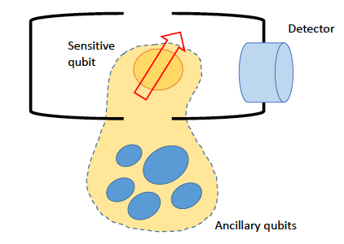
Back to Heisenberg scaling
Tuvia Gefen, David A. Herrera-Martí, AR Phys. Rev. A 93, 032133 (2016)
Notes:
In this slide I will describe the basic idea of error correction

Slide 40
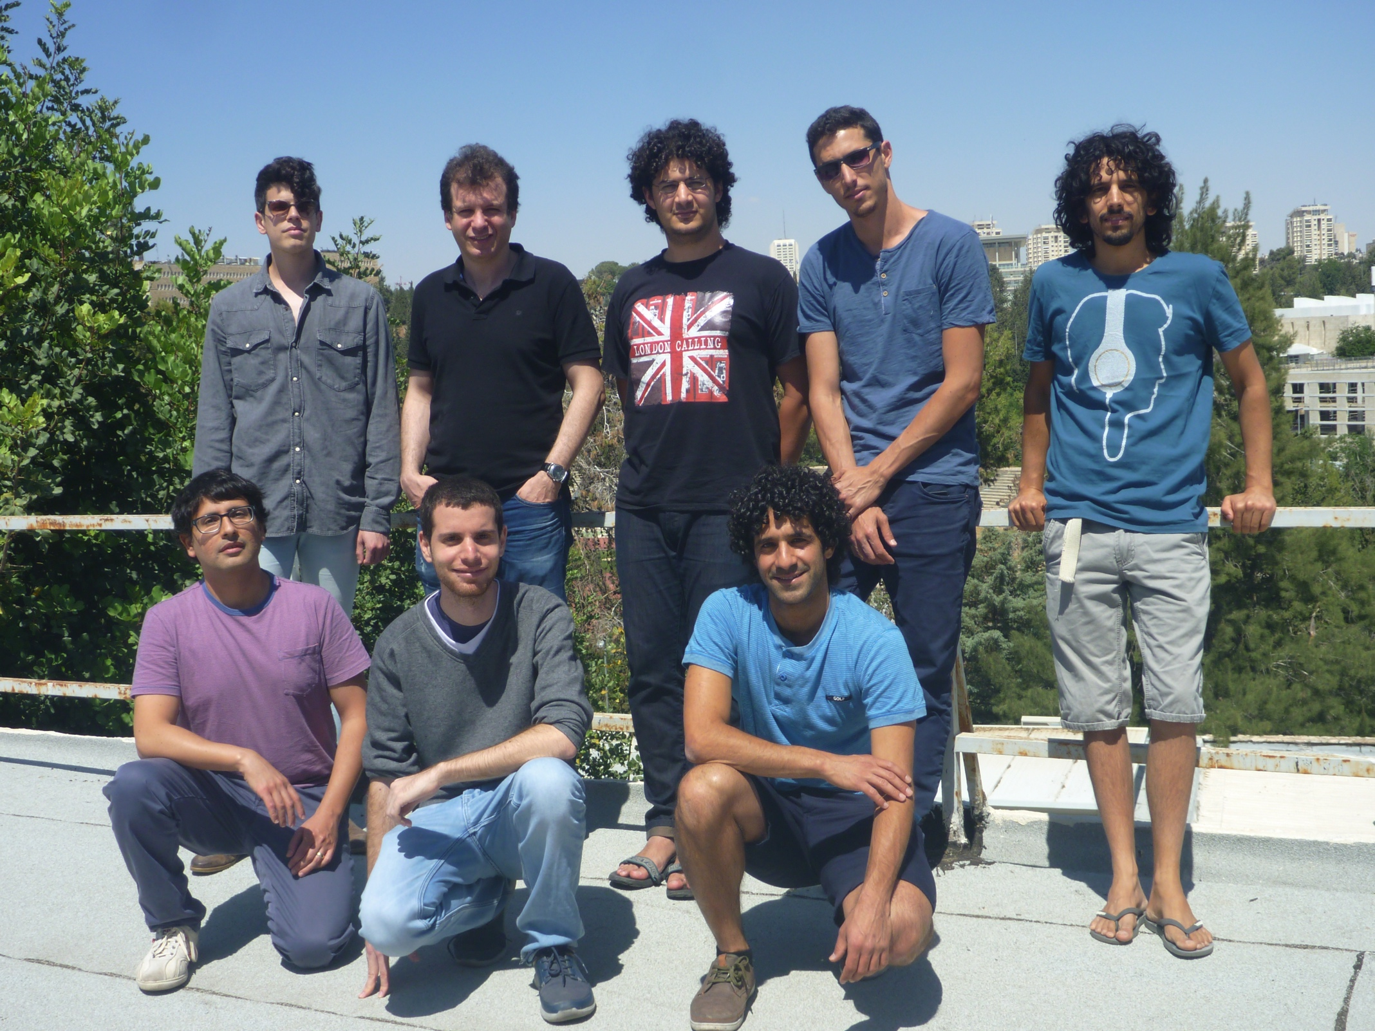
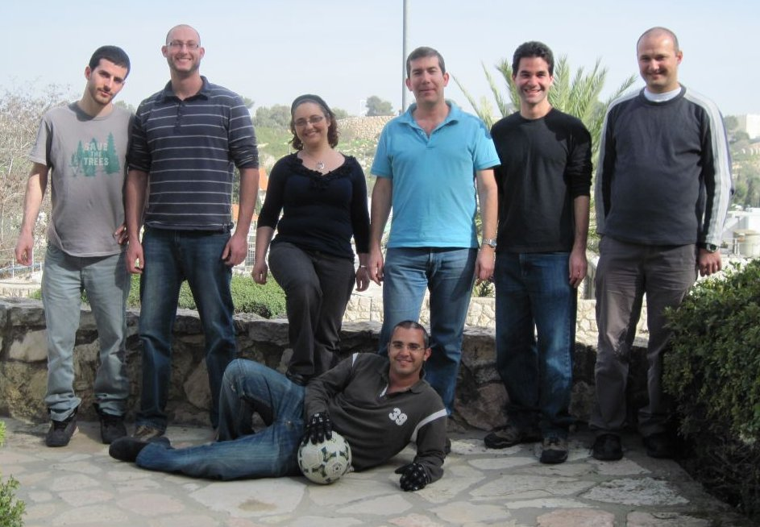
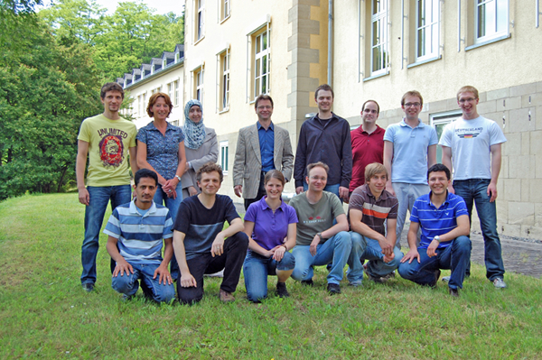
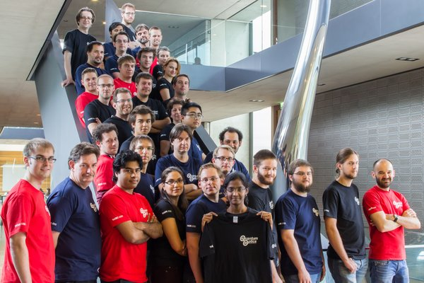
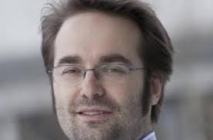
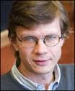

Thanks a lot for your attention!
Diadems
IP (FP7)
CIG
Career integration grant

Slide 41
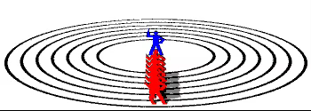
Hahn Echo:

Slide 42
Noise sources - mixing
This state has a
Part:
Notes:
In this slide I will describe the basic idea of error correction

Slide 43
Dressed states – driving fields fluctuations
Robust qubit
Notes:
In this slide I will describe the basic idea of error correction

Slide 44
Noise sources – driving fields fluctuations
The next order shift:
Then the noise is:
Notes:
In this slide I will describe the basic idea of error correction

Slide 45
Magnetic fluctuations
The rotating frame:
Stark Shift
Notes:
In this slide I will describe the basic idea of error correction

Slide 46
XY8:
z
z
y
y
π+δΦ
π+δΦ
x
x
Notes:
Another option is to rotate around y and that’s what lied around the composite pulses idea, i.e., to do pulses of y and then –y instead of y and then y

Slide 47
CP + Meiboom – Gill = CPMG:
z
z
y
y
π+δΦ
x
x
Notes:
Another option is to rotate around y and that’s what lied around the composite pulses idea, i.e., to do pulses of y and then –y instead of y and then y

Slide 48
Quantum Sensing of high frequency fields
Notes:
In this slide I will describe the basic idea of error correction

Slide 49
Dressed states – Noise sources
Deleterious noise at:
Notes:
In this slide I will describe the basic idea of error correction

Slide 50
General scheme for the construction of a protected qubit subspace
Robust subspace
like symmetry protected subspace
Notes:
In this slide I will describe the basic idea of error corrPSAS2016on

Slide 51
Error correction – Shor’s algorithm
Shor’s code:
Bit flip or a phase flip will map this to an orthogonal sub space
For example, phase flip of the first qubit:
For example, bit flip of the first qubit:
Notes:
The proportionality coefficient is \sqrt{log2}

Slide 52
Dressed states
Robust qubit
N. Aharon, I. Cohen, AR in preparation
Notes:
In this slide I will describe the basic idea of error correction

Slide 53
Dressed states – Noise sources
Robust qubit
Notes:
In this slide I will describe the basic idea of error correction

