Slide 1

Ultra-broadband Squeezing as a Resource for Quantum Information
PSAS 2016
Avi Pe’er
(Yaakov Shaked, Yoad Michael, Rafi Vered, Shai Yefet, Michael Rosenbluh)
Physics Dept. and BINA center for nanotechnology, Bar Ilan University
24 May 2016, HUJI

Slide 2
Outline
Time-energy entangled photons (broadband two-mode squeezing) – an amazing quantum resource !
Why no one uses them ? (How to measure ?)
How things are done in RF - mixer based generation and detection
The optical mixer – Ultra broadband optical homodyne
Nonlinear fringe contrast as a Nonclassical measure
The classical-to-quantum transition
What is it good for ? Broadband highly parallel QKD with broadband optical homodyne

Slide 3
Time-Energy Entangled Photons
non linear crystal
pump
signal
idler
The two-photon state (monochromatic pump)
Entanglement
Notes:
the spectrum of a single photon is not defined
all we know is they sum to w_p
such a state is TE ent. We have a superposition of pairs of photons. The wider g(w) , the more pairs we got, the state is more ent.
The width is determined by the phase matching cond. AB mainlt focused on Broadband DC, highly ent.

Slide 4
Time-Energy Correlation
uncertainty relation
the two-photon
wave function (monochromatic pump)
Notes:
in time domain it means….mono->spread in this axis and broadband-> narrow~100fs
the temporal wavefunction depends only on the time dif, where G is the

Slide 5
Ultra-Broadband bi-Photons
Zero Dispersion !
Pump
880nm
PPKTP
CCD
“Single cycle” bi-photons

Slide 6
Why ultra-broad photon pairs ?
Because there are so many of them !

Slide 7
Why not?
Direct detection does not work:
Slow detectors cannot observe the sharp time-correlation
Slow detectors = energy distinguishability
Coincidence detectors saturate at ~10⁶ ph/s
Need some other scheme

Slide 8
Measuring bi-photons - HOM
1
BS
2
SLOW ! (coincidence limit <10⁶ ph/s)
Notes:
in time domain it means….mono->spread in this axis and broadband-> narrow~100fs
the temporal wavefunction depends only on the time dif, where G is the

Slide 9
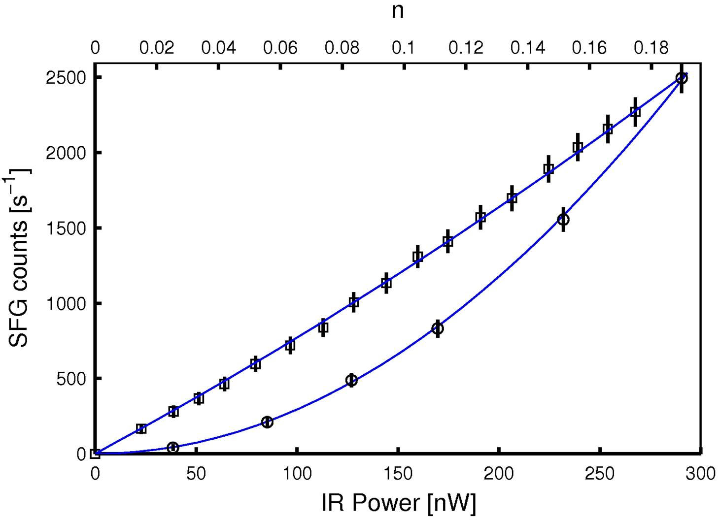
Measuring bi-photons - SFG
Crystal #1
Crystal #2
Pump
SFG
DC
“Efficient” two-photon interaction
SLOW ! (SFG efficiency 10⁻⁸)
PRL 94, 043602 (2005) , PRL 94, 073601 (2005)
Notes:
in time domain it means….mono->spread in this axis and broadband-> narrow~100fs
the temporal wavefunction depends only on the time dif, where G is the

Slide 10
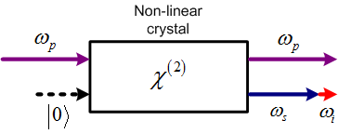
Squeezed light?
Y
Y
ΔX
ΔX
ΔY
ΔY
- undefined
<|E|>=0
ϕ
X
X
Parametric process
Quantum Uncertainty Principle

Slide 11
Homodyne Measurement
Local
Oscillator
LO
Y
θ_{LO}
ω
Square Law Detectors
X
Beam Splitter
Photo Detectors

Slide 12
Two-mode squeezed light
LO-1
LO-2
Use two separate phase locked LO’s!
Δ
Δ
Y
+Δt
ω_{s}
ω_{dg}
ω_{i}
Too fast for detectors!
X
−Δt

Slide 13
Two-mode squeezing – Time domain
X(t) = cos(δt + ϕ_{x})
Y
Y
Y(t) = cos(δt + ϕ_{y})
+δt
A_{s}
X
X
A_{i}
−δt
A_{s}
A_{i}
+δt
−δt
X(t) cos(ω₀t)
Y(t)sin(ω₀t)

Slide 14
RF analog
RF frequency mixer
Amplifier
Regenerative frequency divider
RF homodyne measurement
Squeezed
Signal
Local Oscillator
Coupler
Quadrature information
TMSS
(two-mode squeezed state)
Same mixer for generation and detection.
Use non-linear crystal for homodyne measurement!

Slide 15
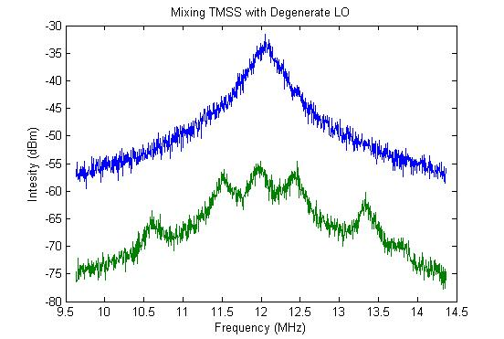
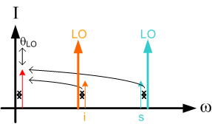
Three scenarios:
~23dB
squeezing!
1. Degenerate LO
3. Pump+DC LO
2. Two-mode LO
DC and pump frequency are a pair!
No need for exact LO frequencies,
only their sum!
Two-mode LO generated in parametric oscillator
Marino, Alberto M., et al. "Bichromatic local oscillator for detection of two-mode squeezed states of light." JOSA B 24.2 (2007): 335-339.

Slide 16
Optical experiment
Squeezed signal
GENERATION
PHASE
TMSS generation
Mixing with pump
MIX signal with pump
(MIX idler with DC)
Phys. Rev. Lett. 72, 629-632 (1993).
“Frustrated Two-Photon Creation via Interference“
(Herzog, Rarity, Weinfurt and Zeilinger)
Phys. Rev. A 33, 4033 (1986)
“SU2-and-SU11-Interferometers" , (Yurke, McCall, and Klauder)
INTERFERENCE inside non-linear crystal.
New J. Phys. 16, 053012 (2014) “Observing the non-classical nature of ultra-broadband bi-photons at ultrafast speed” (Shaked, Pomerantz, Vered, Pe’er)
New J. Phys. 17, 073024 (2015) “Octave-spanning spectral phase control for single-cycle bi-photons” (Shaked, Yefet, Geller, Pe’er)

Slide 17
Non linear Mach Zehnder
An equivalent Mach-Zehnder interferometer for Bi-photons:
Two Photon BS
Two Photon BS

Slide 18
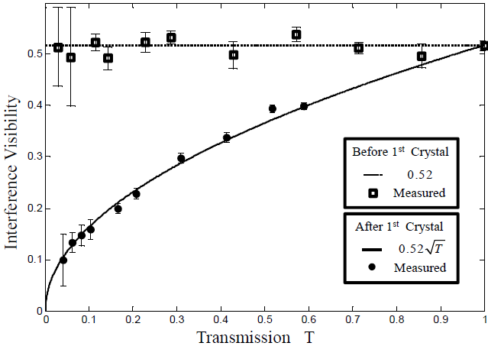
What is non-classical ?
A
Pump laser (880nm)
CCD camera
B
Crystal 1
Crystal 2
Pump
power meter
A
Measure of the
two-photon purity
B
SPEED !
Full flux detected

Slide 19
Now to FWM…
Down conversion
Four Waves Mixing
non linear crystal
non linear fiber
pump
signal
pump
signal
idler
idler
ω_{i}
energy
conservation
2ω_{p}
ω_{s}
momentum
conservation
(phase matching)
k_{i}
k_{s}
2k_{p}

Slide 20
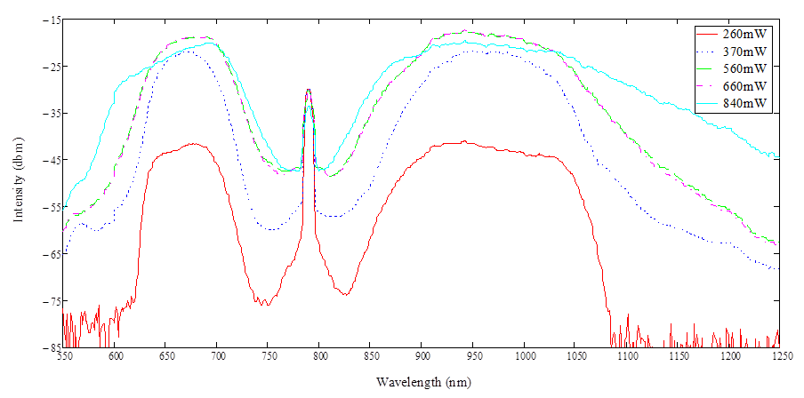
The Experiment
6ps
Ti:S Laser (6ps)
PCF
Spontaneously generated signal-idler (ASE)
Spectrometer
Pump filter
Dispersive window
Different from supercontinnum generation! INCOHERENT – No comb
Unique regime compared to CW – High gain
Can cover the full Quantum-Classical transition
Rafi Z. Vered, Michael Rosenbluh, and Avi Pe’er,
“Two-photon correlation of broadband-amplified spontaneous four-wave mixing”, Phys. Rev. A 86, 043837 (2012)

Slide 21
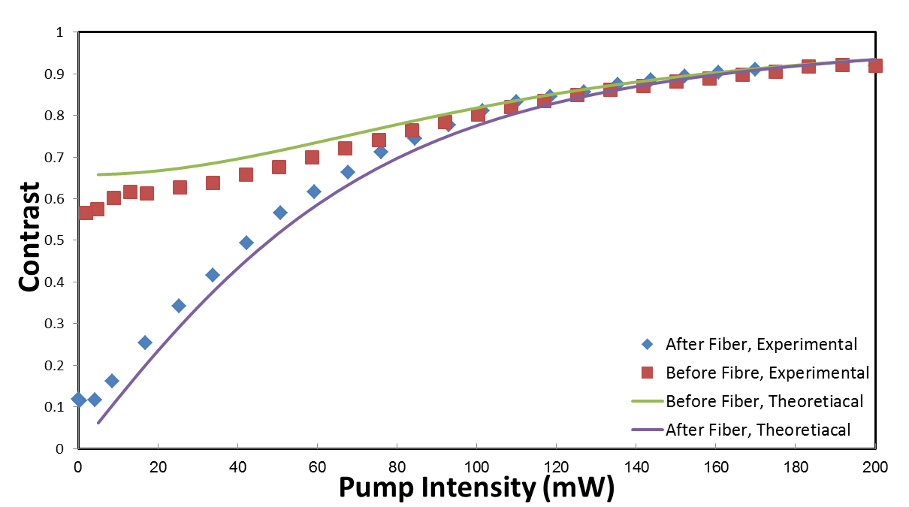
Classical-to-quantum transition
Quantum regime
Classical regime
Phys. Rev. Lett. 114, 063902 (2015)
“ Classical-to-Quantum Transition with Broadband Four-Wave Mixing” (Vered, Shaked, Rosenbluh and Pe’er)

Slide 22
Can we measure squeezing ?

Slide 23
Measurement of FWM Squeezing
Beneath Vacuum Level
~35% squeezing
Intensity (A.U.)
wavelength (nm)
In preparation (2016)
Optical measurement of quantum squeezing

Slide 24
Measurement Recipe
Parametric Amp.
Calibration:
Extract :

Slide 25
Conclusions (I)
Bandwidth allows ultra-high flux of collinear “single cycle” bi-photons
The pumped crystal acts as a bi-photon detector with near unit efficiency.
No coincidence detection ! Standard intensity detection at the bi-photons rate
Comparing single-photon loss with two-photon loss verifies non-classical behavior.
Speedup ! X10⁴ demonstrated, X10⁸ feasible

Slide 26
Conclusions (II)
Observation of the entire classical-quantum transition with FWM in fiber
Span 8 orders of magnitude (and more…)
Bi-photon generation with imaginary gain
RF parametric oscillation as a Semi-classical physical simulator.
Use optical nonlinearity as an optical mixer for measuring broadband two-mode squeezing.
Must be useful for something…
Thank You

Slide 27
Classical model
Crystal 1
Crystal 2
Noise…

Slide 28
Quantum model
Crystal 1
Crystal 2

Slide 29
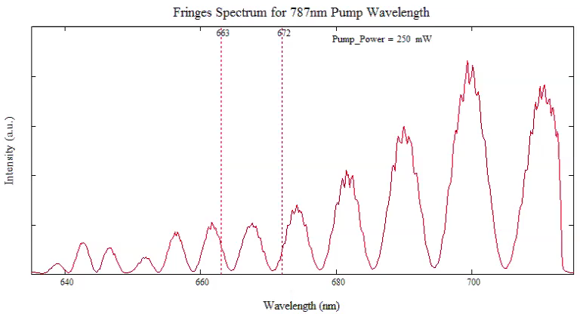
FWM – nearby pump wavelength
Shift pump - 787nm (Δk<0, threshold for gain)
Phase shift with intensity

Slide 30
FWM – nearby pump wavelength
Imaginary gain ?
Squeezing ?

Slide 31
FWM Gain Solution
Signal/idler solution
Similar to 3-waves, but…
Generalized phase mismatch
Gain can become imaginary !
Correlation ?

Slide 32
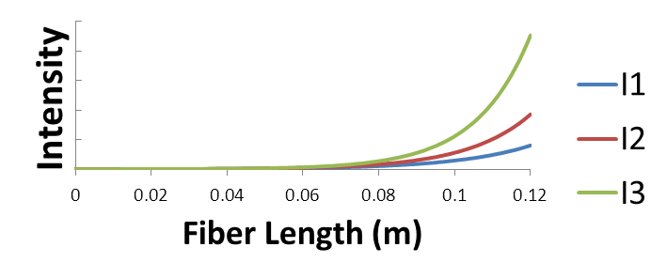
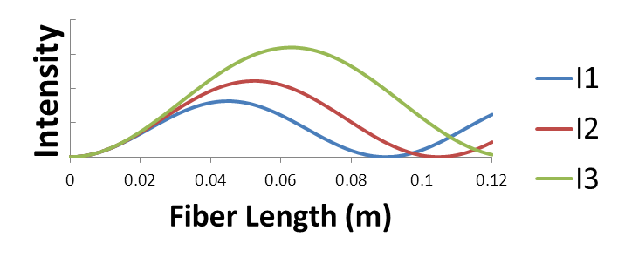


Imaginary gain ?
For real gain:
$$I_{FWM}∝\frac{I_{p}^{2}}{g^{2}}\sinh^{2}\left(gl\right)$$
For imaginary gain:
$$I_{FWM}∝l^{2}I_{p}^{2}{sinc}^{2}\left(\left|g\right|l\right)$$
$$I_{3}>I_{2}>I_{1}$$

Slide 33
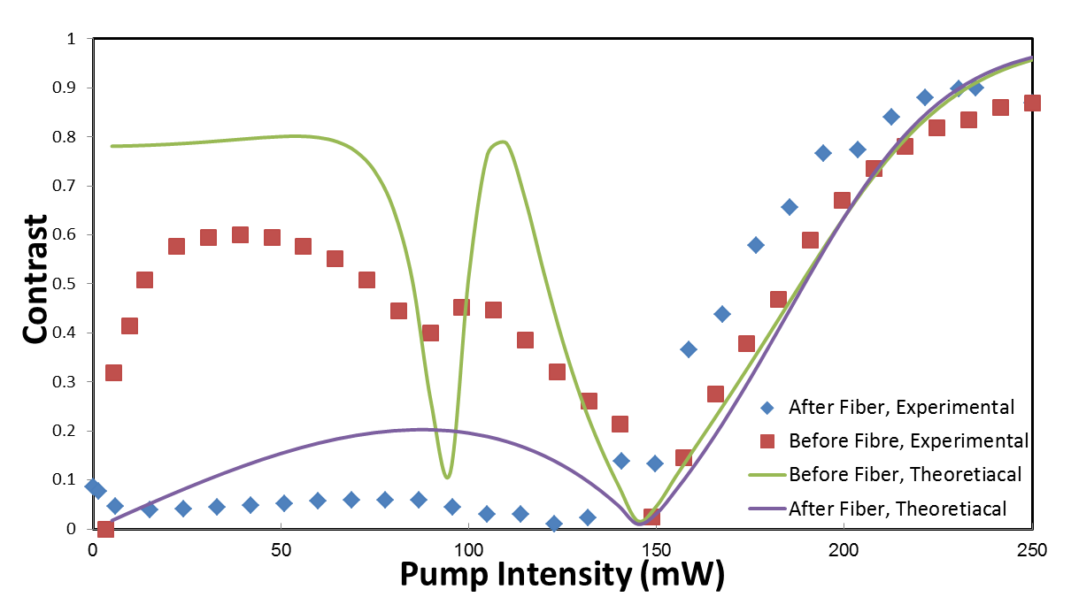
Theory vs experiment
Contrast reduction ?
Pulse effects, Spectrometer resolution

