Slide 1
Precision Atomic Physics in the Solar Interior
Menahem Krief
Alexander Feigel
Doron Gazit
The Racah Institute of Physics, The Hebrew University

Slide 2
Outline
Radiative transfer in the solar interior
The role of atomic physics in solar modelling
State of the art atomic models for hot dense plasmas
A current problem in solar physics may be solved with more “precise” atomic physics

Slide 3
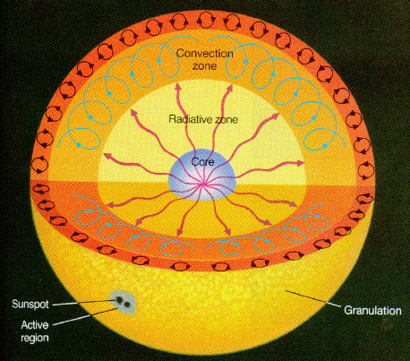
The Solar Interior
Radiative Zone – Energy transport by radiation
Photon Mean Free Path $\sim 1cm$<< Rsun (${\sim \text{10}}^{11}cm$)
Atomic spectra -> Photon Mean Free Path <-> Opacity
Atomic physics at extreme conditions
Photon diffusion
Convection Zone
Energy transport by convection

Slide 4
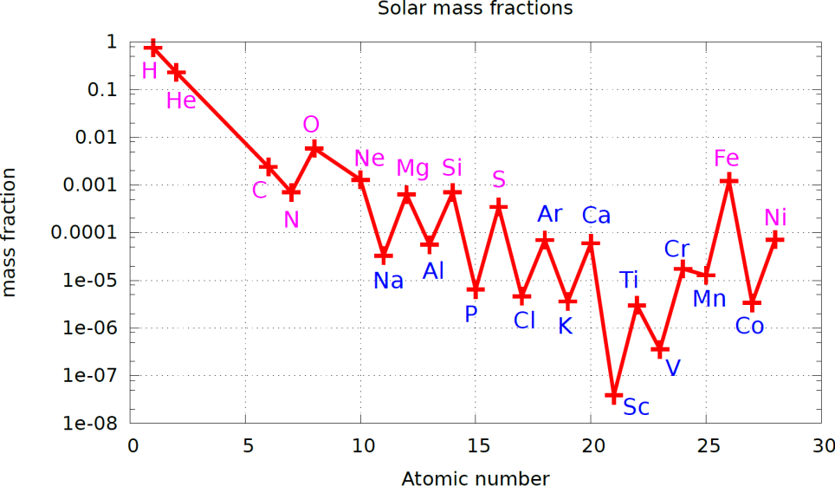
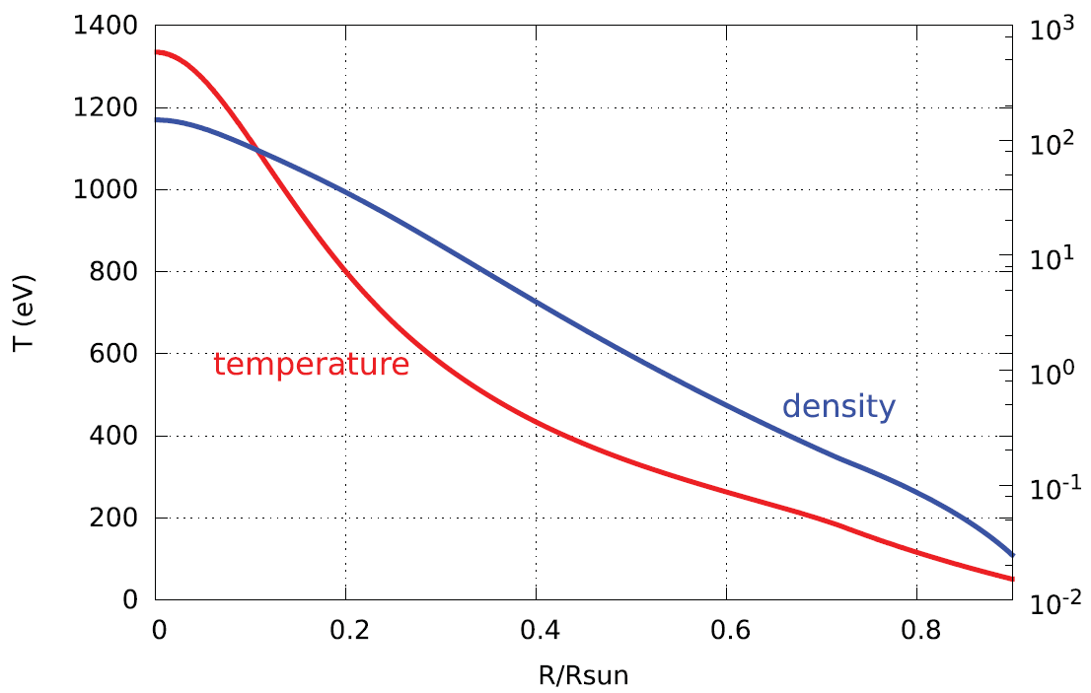
Mid-Z Elements in The Solar Composition
Solar mixture abundances
98% H+He
Other ~2% – “Metals”
Most metals
Extreme Conditions
A Hot-Dense Plasma
fraction
CZ
Temp. (eV)
Density
Density (g/cc)
Temperature

Slide 5
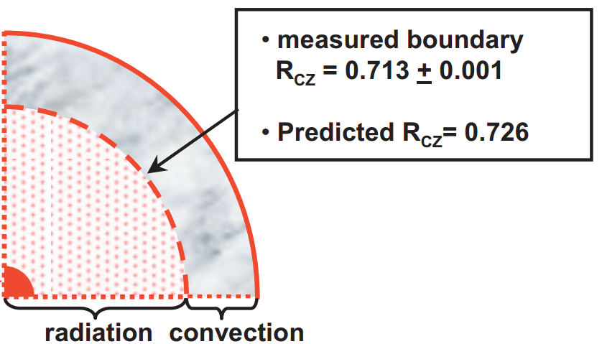
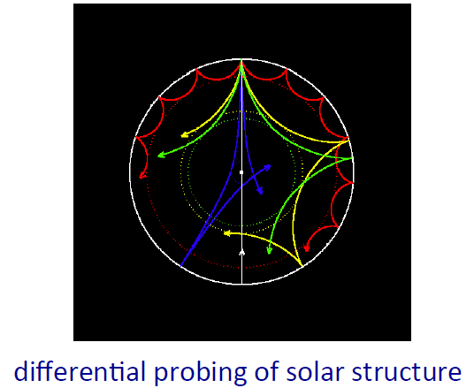
The Solar Abundance Problem
Standard Solar
Model (SSM)
Hydrostatic
1D
Opacities
Eqs. of state (EOS)
Nuclear rates
…..
Rcz – convection zone
Ycz – Helium abundance
Sound speed profile
Abundances
Solar atmosphere
spectra (1D\3D)
Meteorits
Helioseismology
$\sim 10σ$discrepancy!
Bailey, J. E., et al. 2009

Slide 6
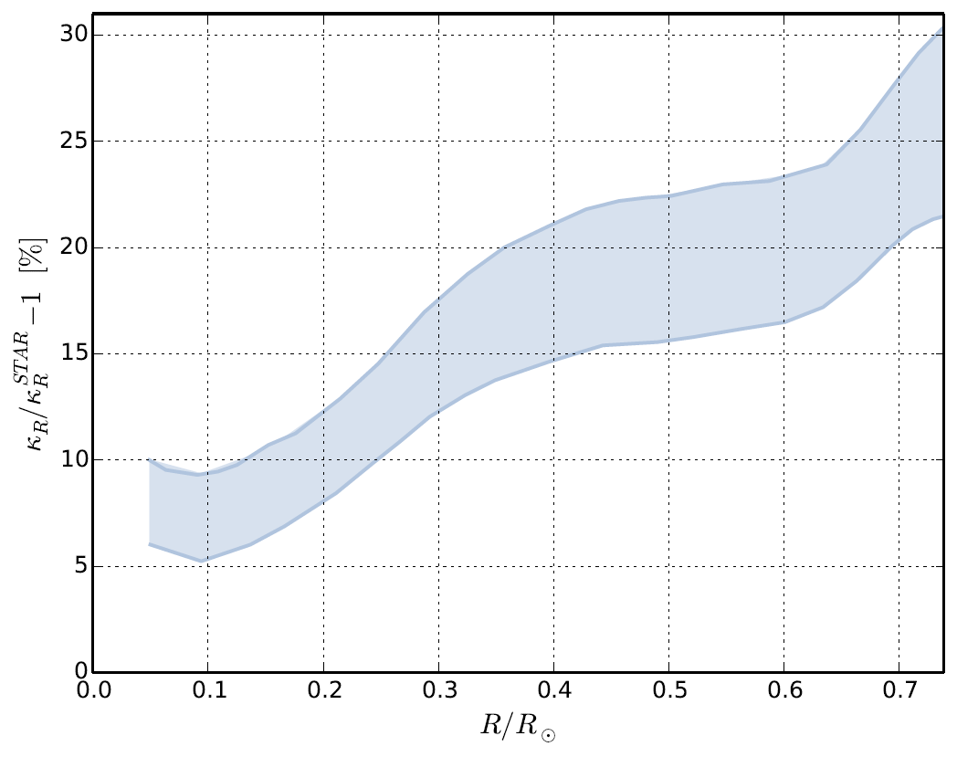
Precise Observations give a Constrained Opacity profile
20%~ less metals in new abundances
Metals determine most of the opacity, but not EOS
No measurements at solar conditions
Solar opacities are exclusively theoretical
Very complicated models
Opacities are believed to be the “source” of the problem
Other ideas – revised solar models (magnetic fields, rotation etc.) no satisfactory model exists
Fractional opacity variation to fit the data
The Sun
Helioseismology, neutrinos
F.L. Villante and B. Ricci - APJ 2010
F.L. Villante - APJ 2010
Bergemann, and A Serenelli. 2014

Slide 7
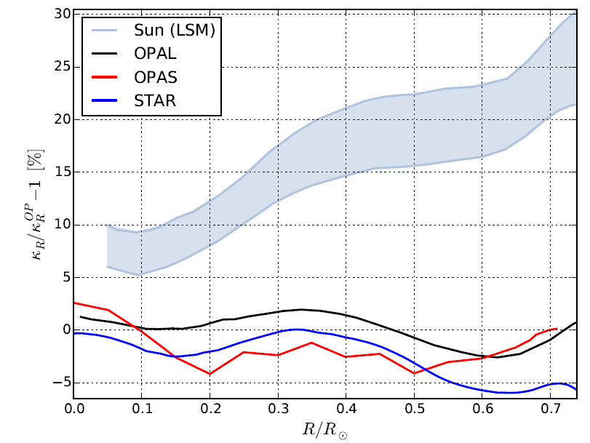
Missing Opacity – a “Solar OPACITY Problem”
The Sun
Helioseismology, neutrinos
Missing
Opacity
OpacityModels
Our
Model
M. Krief, A. Feigel, and D. Gazit, “Line broadening and the solar opacity problem”, ApJ 2016
Blancard, et. Al ApJ 745.1 (2011): 10 & Iglesias et al. ApJ 464 (1996): 943.

Slide 8
Steps Towards Solution
Point out and check physics “beyond” current state of the art atomic models
Alternatively, point out and quantify sources of uncertainty in atomic models and check sensitivities
We have developed state of the art atomic models in order to investigate the source of the solar opacity problem
M. Krief, A. Feigel, and D. Gazit, “Line broadening and the solar opacity problem”, ApJ 2016
M. Krief, A. Feigel, and D. Gazit, “Solar opacity calculations using the super-transition-array method” ApJ , 2016
M. Krief, A. Feigel “Variance and shift of transition arrays for electric and magnetic multipole transitions”, HEDP 2015
M. Krief, A. Feigel “The effect of first order superconfiguration energies on the opacity of hot dense matter”, HEDP 2015

Slide 9
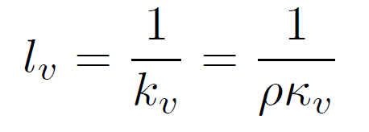
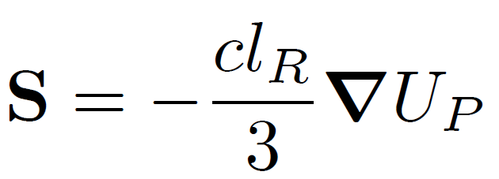
The Rosseland Opacity
Photon mean-free-path
Radiative heat transfer – diffusion approximation at each frequency
Rosseland Mean
Energy
Flux
Planck Energy Density

Slide 10
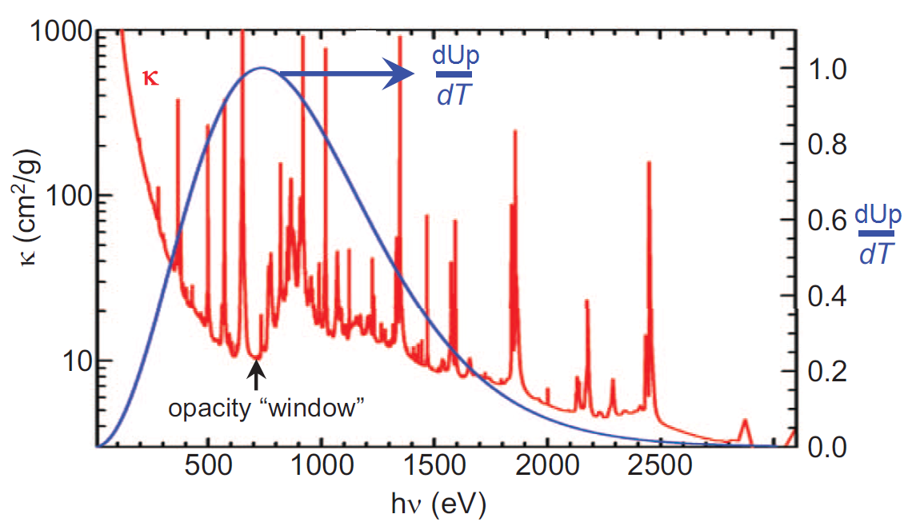
The Rosseland Opacity
Iron @ Convection Zone
4kT
Bailey, J. E., et al. 2009
Photon mean-free-path
Radiative heat transfer – diffusion approximation at each frequency
Rosseland Mean

Slide 11
Photons Escape Through Opacity “Windows”
Marcel Klapisch, APIP, April 2016

Slide 12
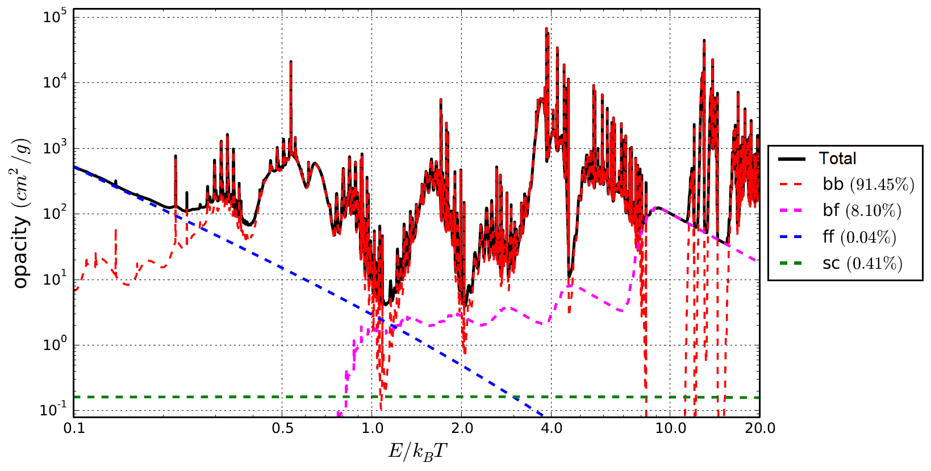
Atomic Transitions
Scattering
Typical opacity spectra of a mid-Z element
Free-Free
Bound-Bound
Free-Free
Bound-Free
Rosseland
Fraction
Bound-Free
Scattering
Bound-Bound
Bound-Bound and Bound-Free dominate by orders of magnitude
Existence of bound electrons strongly increases opacity

Slide 13
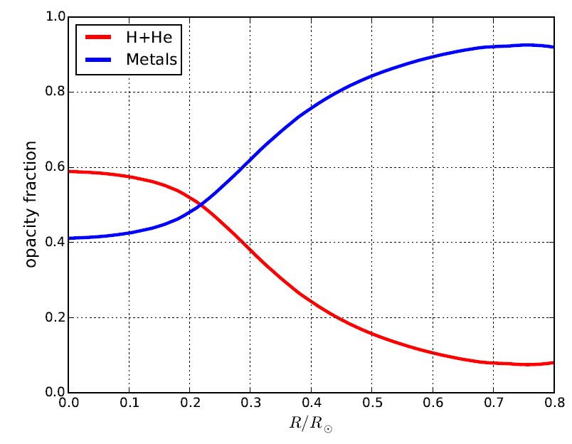
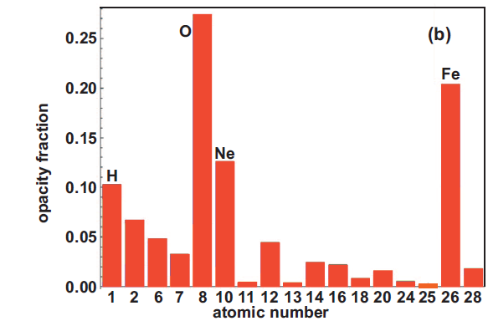
Metals are a major source of opacity in the Sun
Opacity contribution
CZ
Metals
Opacity fractions
@Convection zone
Bailey, J. E., et al. 2009
H+He
Metals have numerous bound electrons
Metals are a significant source of opacity in the sun
Atomic physics of hot dense plasmas of mid-Z elements
M. Krief, A. Feigel, and D. Gazit, “Line broadening and the solar opacity problem”, ApJ 2016

Slide 14
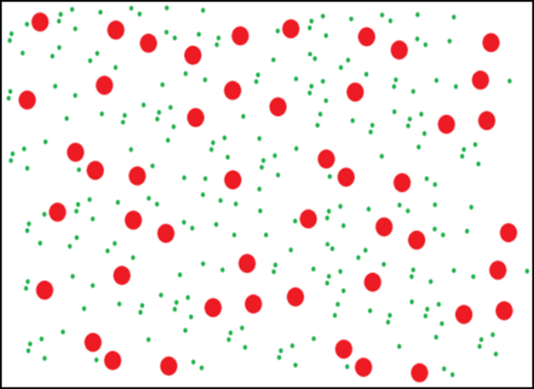
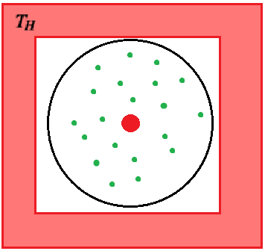
The Ion-Sphere model
The plasma is divided into spherical cells
The density dictates the size of the “Wigner-Seitz“ cell, in which neutrality is imposed
The surrounding plasma of each cell is considered a heat bath

Slide 15
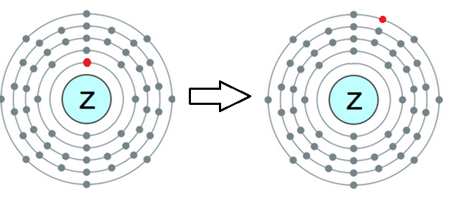
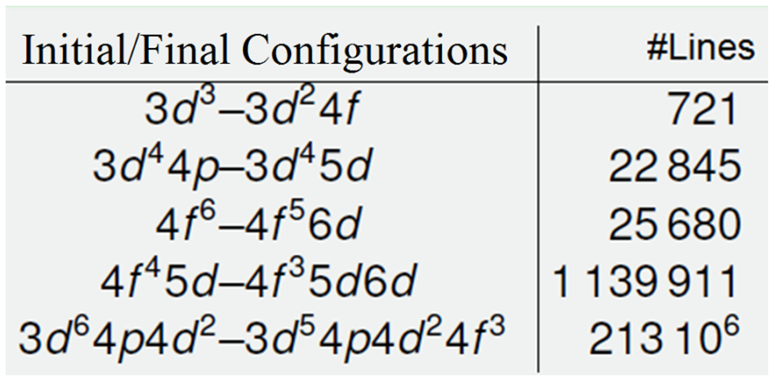
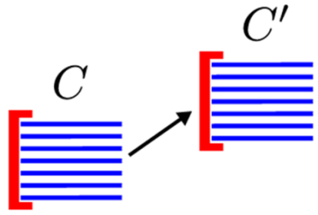
Specification of the Bound-Bound Atomic Transitions
Atomic Structure
Levels within configurations
An Atomic Configuration
A large number of transitions between levels of configuration pairs
Q. PORCHEROT et. al 2012

Slide 16
The Bound-Bound Opacity Spectra
Level
Population
Transition
Amplitude
Transition
Energy
Lineshape
Orbital Jumps
Configurations
10-1000
Levels
Two major difficulties:
For mid-Z and high-Z elements - a HUGE number of lines for each pair of configurations
For hot plasmas - a HUGE number of atomic configurations must be included

Slide 17
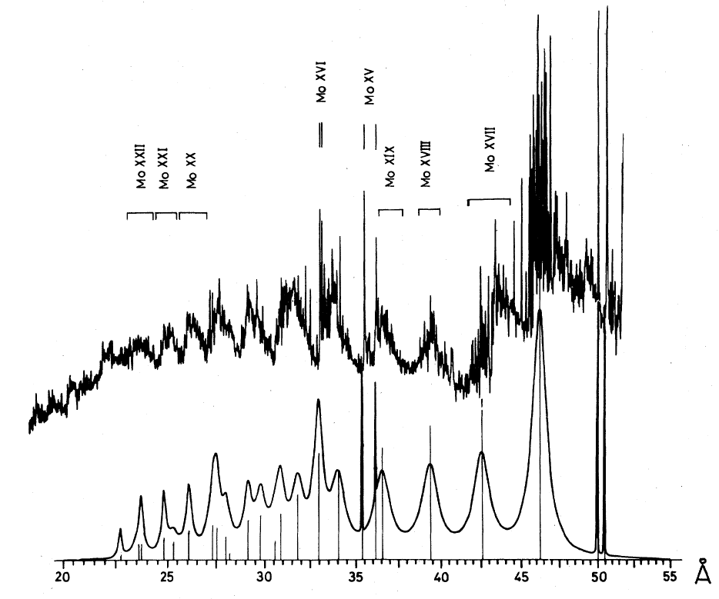
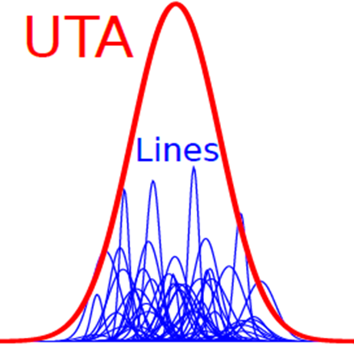
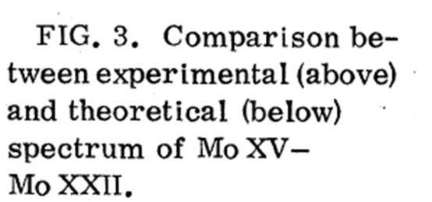
Unresolved Transition Arrays (UTA)
In a hot plasma, the large number of lines between pairs of configurations often overlap and can be approximated by a single “effective” line
Calculate only the moments of the effective lines
Intensity
Transition Energy
Exp. Spectra
UTAs
Energy Variance
Bauche-Arnoult, C., J. Bauche, and M. Klapisch. PRA 1979

Slide 18
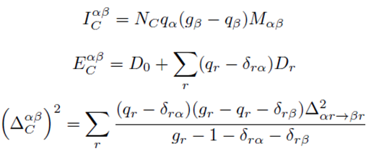
The moments have EXACT expressions
Polynomials in occupation numbers
The coefficients are averages of 2-electron configurations
A very elegant decomposition of a many body problem into two-body problems
Many body
Two-body
Bauche-Arnoult, C., J. Bauche, and M. Klapisch. PRA 1979
Bar-Shalom, A., J. Oreg, and W. H. Goldstein. PRE 1995

Slide 19
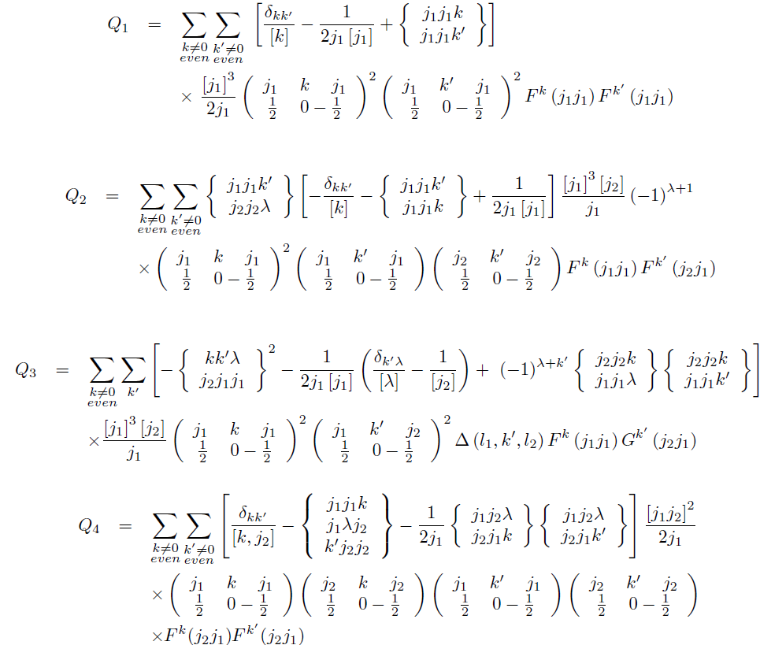
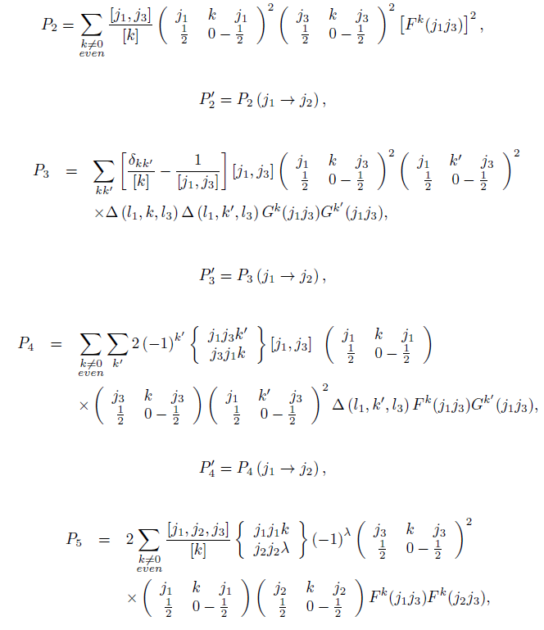
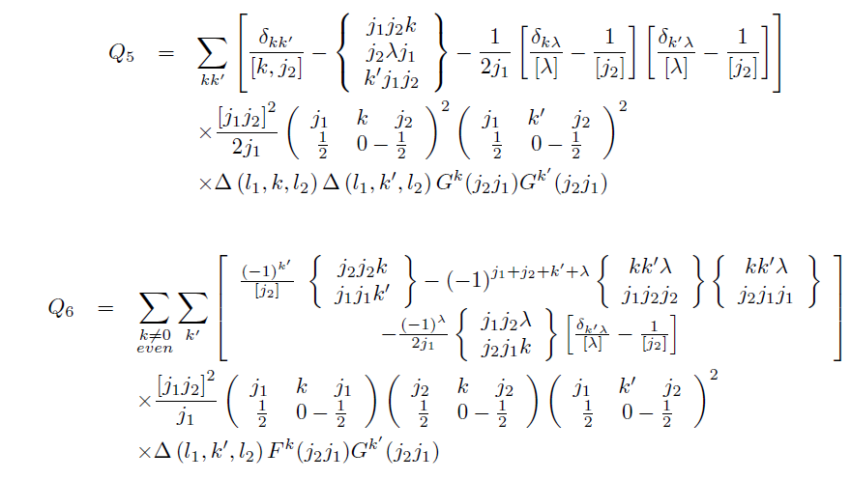
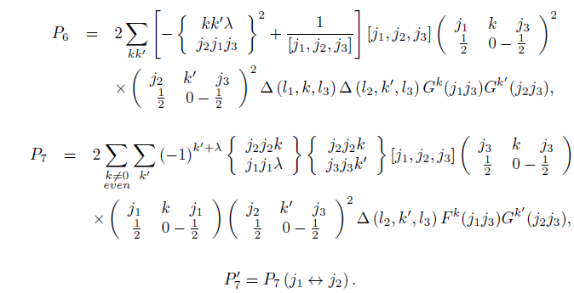
Equivalent Electrons
Non-Equivalent Electrons
...
...
M. Krief, A. Feigel “Variance and shift of transition arrays for electric and magnetic multipole transitions”, HEDP 17 2015 254–262
Bauche-Arnoult, C., J. Bauche, and M. Klapisch. Physical Review A 31.4 (1985): 2248.‏
Bar-Shalom, A., J. Oreg, and W. H. Goldstein. Physical Review E 51.5 (1995): 4882.‏

Slide 20
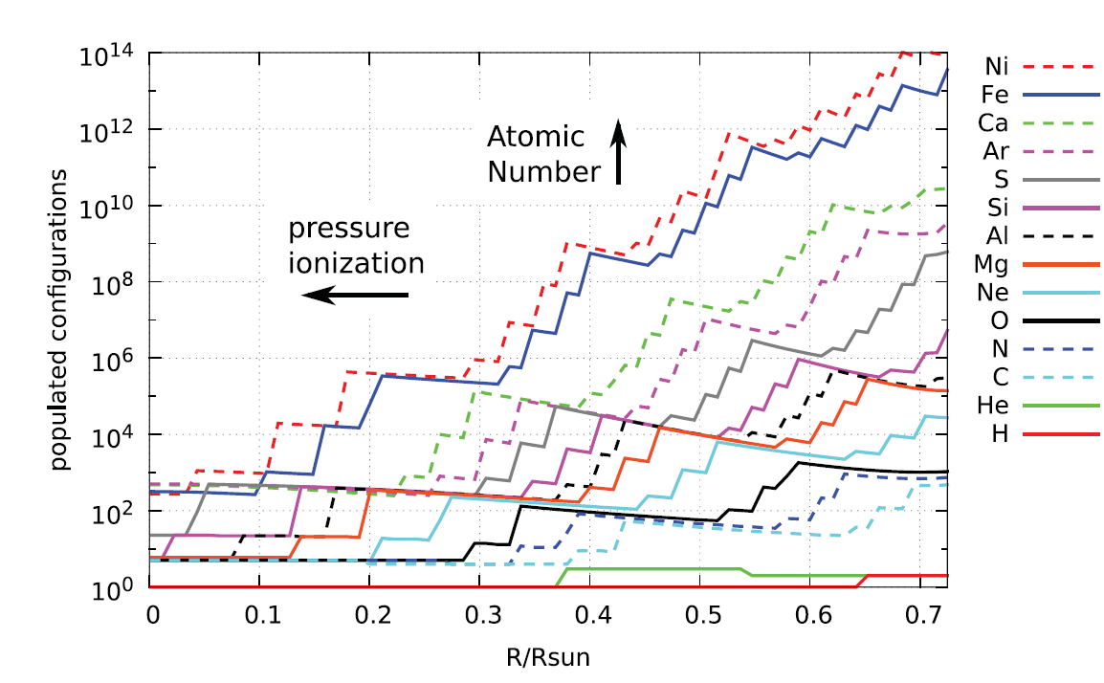
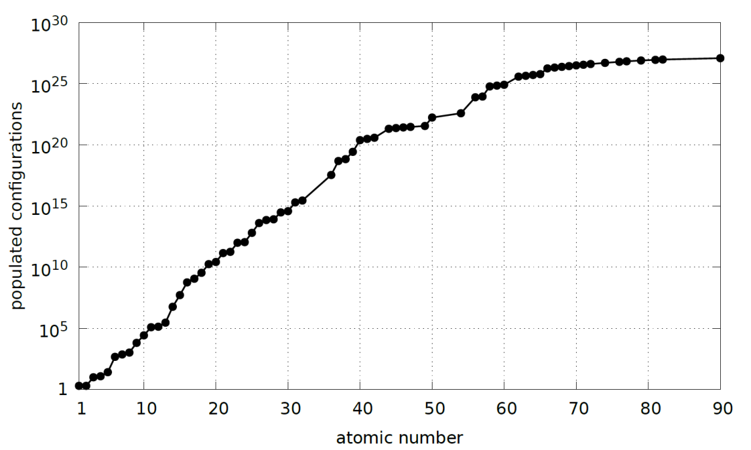
A Huge Number of Configurations In The Solar Interior
Most abundant elements across the sun
All elements
at the CZ boundary
@Convection Zone
M. Krief, A. Feigel, and D. Gazit, “Solar opacity calculations using the super-transition-array method” ApJ , 821:45, 2016

Slide 21
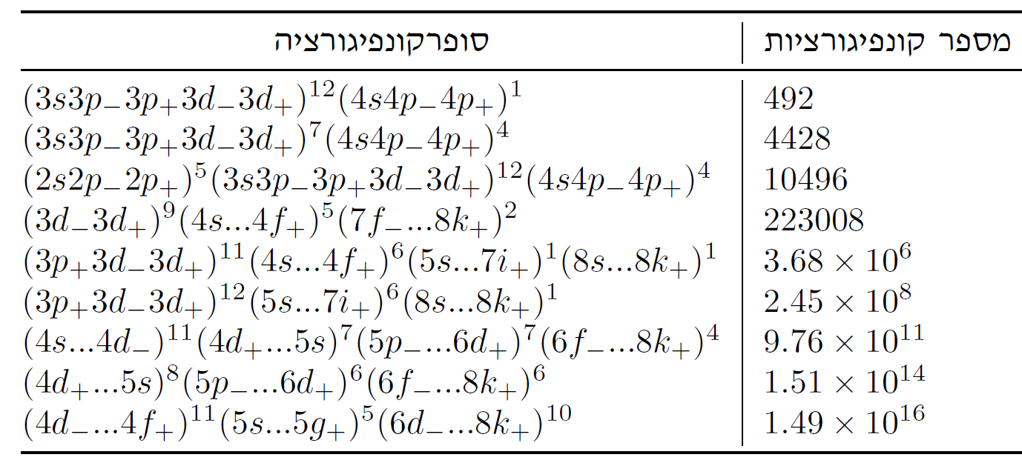
The Solution – SuperConfigurations The Super Transition Array Model (STA)
Super-Shells
Super-Configurations
Shells (1s,2p etc.)
Configurations
Superconfiguration
#Configurations
Bar-Shalom, A., et al PRA (1989)

Slide 22
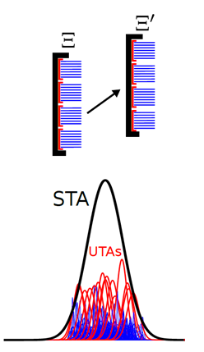
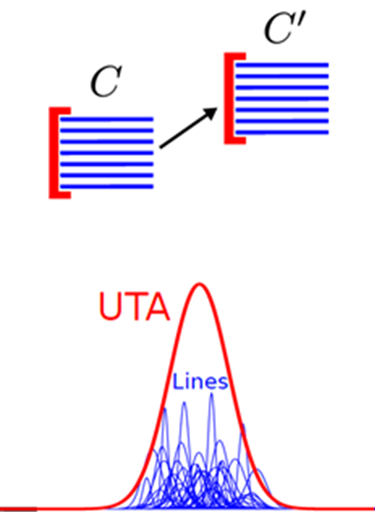
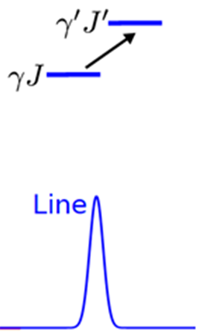
The Coarse-Graining Hierarchy
Configurations:
Levels
Coarse Graining

Slide 23
Missing Opacity – a “Solar OPACITY Problem”
The Sun
Helioseismology, neutrinos
Missing
Opacity
OpacityModels
We have developed a STA atomic code (STAR)
Our
Model
M. Krief, A. Feigel, and D. Gazit, “Line broadening and the solar opacity problem”, ApJ 2016
Blancard, et. Al ApJ 745.1 (2011): 10 & Iglesias et al. ApJ 464 (1996): 943.

Slide 24
Possible explanations?
Source of problem
Contribution from High-Z elements?
Effect of the Plasma environment?
Coarsed Grained Atomic calculation (STA procedure)?

Slide 25
Possible explanations?
Source of problem
Contribution from High-Z elements?
Effect of the Plasma environment?
Coarsed Grained Atomic calculation (STA procedure)?
STA calculations of solar opacities show a very good agreement with DETAILED calculations

Slide 26
Possible explanations?
Source of problem
Contribution from High-Z elements?
Effect of the Plasma environment?
Coarsed Grained Atomic calculation (STA procedure)?

Slide 27
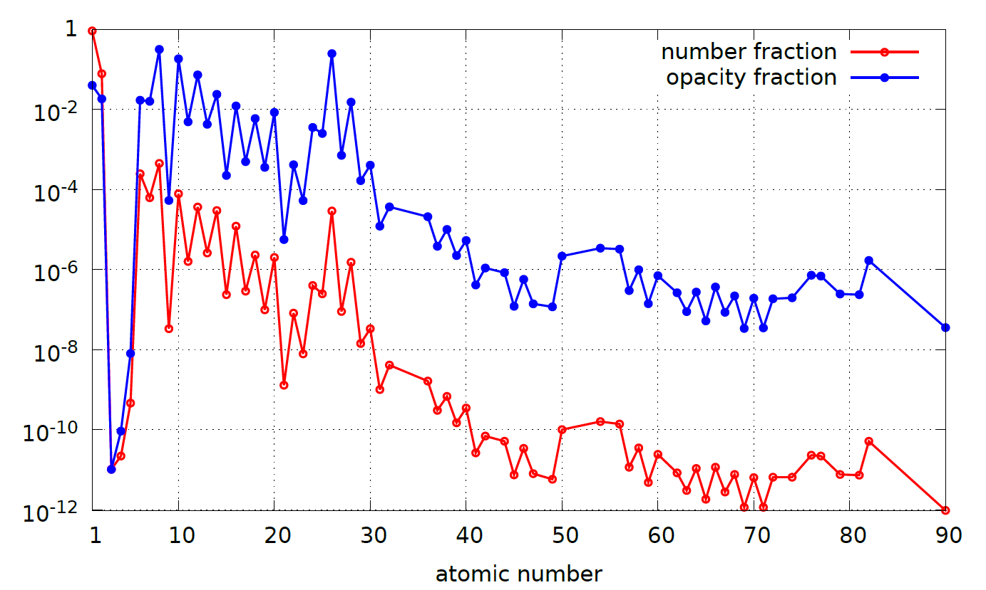
Effect of heavy elements?
Calculation is possible only with STA
Opacity fraction
Fraction
Number fraction
M. Krief, A. Feigel, and D. Gazit, “Solar opacity calculations using the super-transition-array method” ApJ , 821:45, 2016
Iglesias, C. A., Wilson, B. G., Rogers, F. J., Goldstein, W. H., Bar-Shalom, A., & Oreg, J. (1995). APJ, 445, 855-860.

Slide 28
Possible explanations?
Source of problem
Contribution from High-Z elements?
Effect of the Plasma environment?
Coarsed Grained Atomic calculation (STA procedure)?
Line Shapes
Level populations
Line-Shifts (screening)

Slide 29
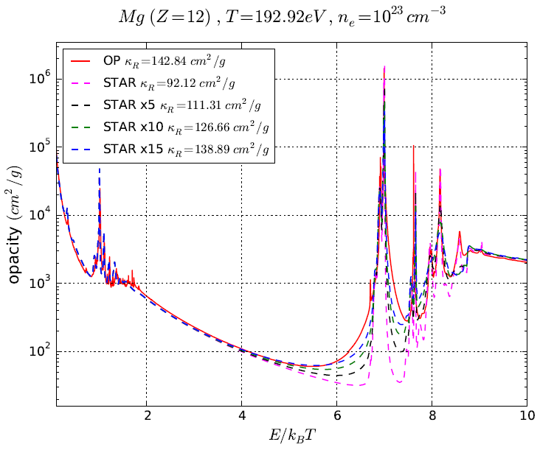
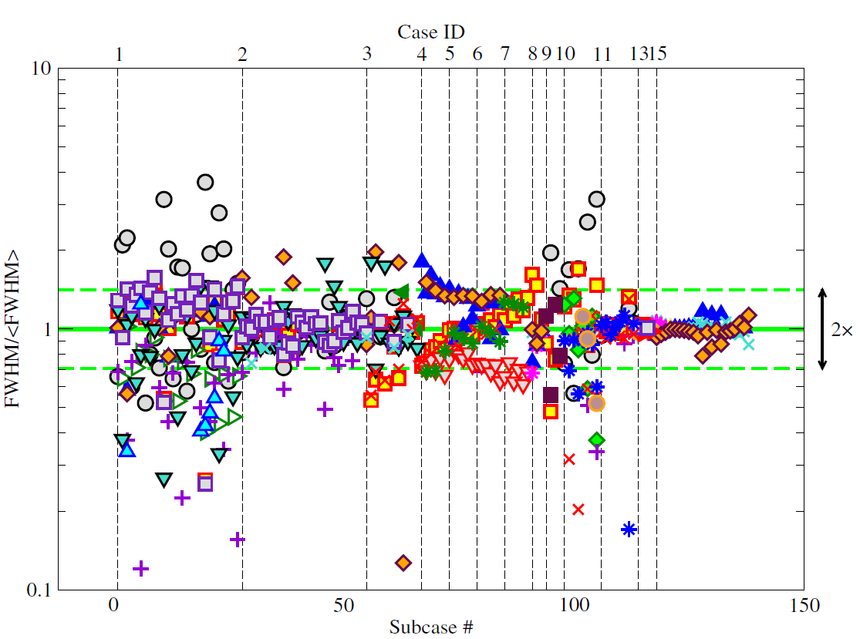
Uncertainties in collisional line broadening
A complex many body phenomena
Different models show large differences (between x2 to x15)
Was never directly measured at stellar interior conditions
Comparisons with OP (Detailed) shows at least a factor of x15
Various Lines
Magnesium
R=0.72Rs
Width ratio
M. Krief, A. Feigel, D. Gazit, ApJ 2016
E. Stambulchik 2013
S. Ferri et al. 2014

Slide 30
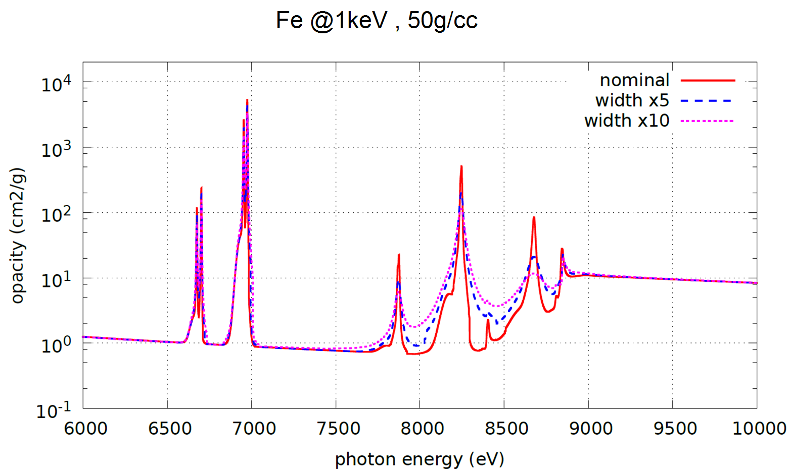
Broadening affects opacity windows
Iron K shell near the solar core

Slide 31
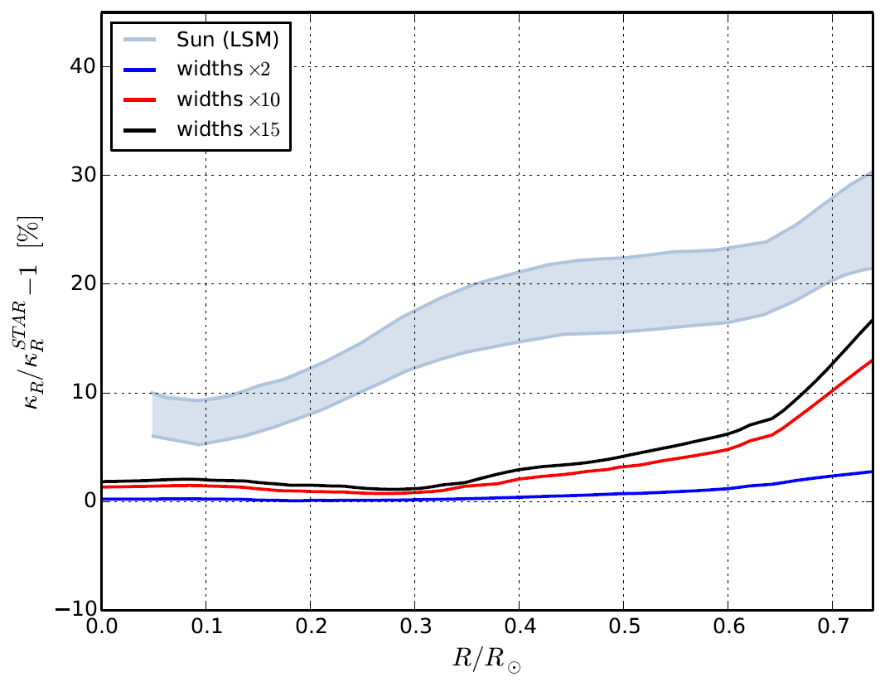
Opacity variations resulting from uncertainties in collisional line broadening
The sun
Helioseismology, neutrinos
x15
x10
x2
No experimental data - what is the actual uncertainty of current models?
M. Krief, A. Feigel, and D. Gazit, “Line broadening and the solar opacity problem”, ApJ 2016

Slide 32
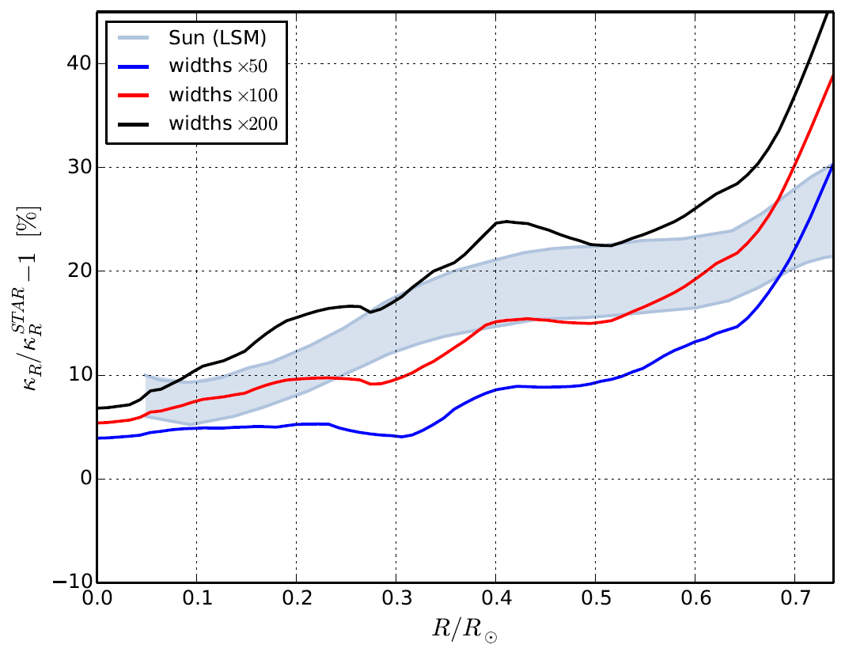
A factor of ~100 is needed to solve the problem quantitatively and qualitatively
The sun
Helioseismology, neutrinos
x200
x100
x50
x100 is not that big considering the fact that OP and STAR show x15 in the K-shell…
The uncertainty may depend on the line, atomic number, temperature and density
M. Krief, A. Feigel, and D. Gazit, “Line broadening and the solar opacity problem”, ApJ 2016

Slide 33
Summary
Precise atomic calculations at solar conditions are required to understand the solar problem
Collisional line broadening - a complicated effect which was never tested at solar conditions - may reduce some of the missing opacity
Better theory is called for… or at least better uncertainty estimate.
Future work: other plasma effects?

Slide 34
THANK YOU

Slide 35
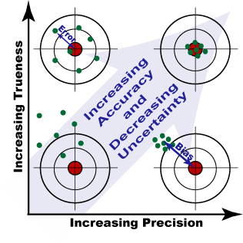
Holy grail of precision physics: precision theory does not match precision experiment

Slide 36
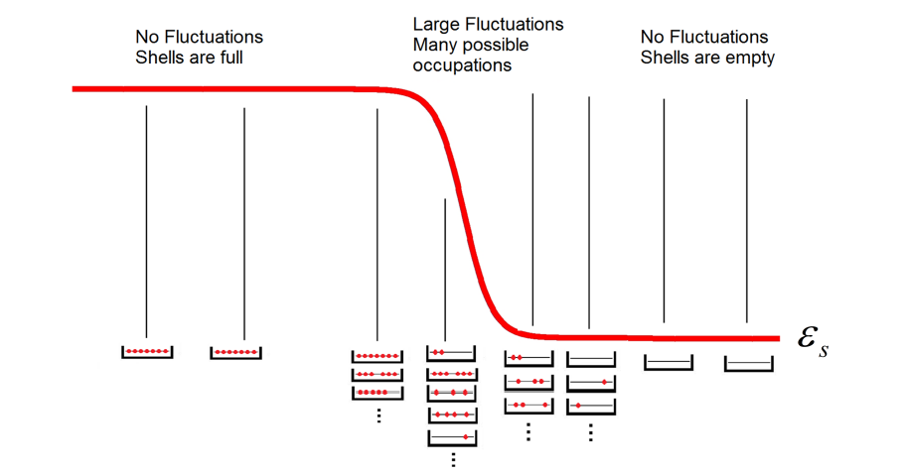
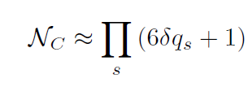
The Number of Configurations in a Hot plasma
Configurations
Distribution is
Binomial
Fluctuations
In shell occupation numbers
“Width” of the
distribution – The number
of occupied configurations

Slide 37
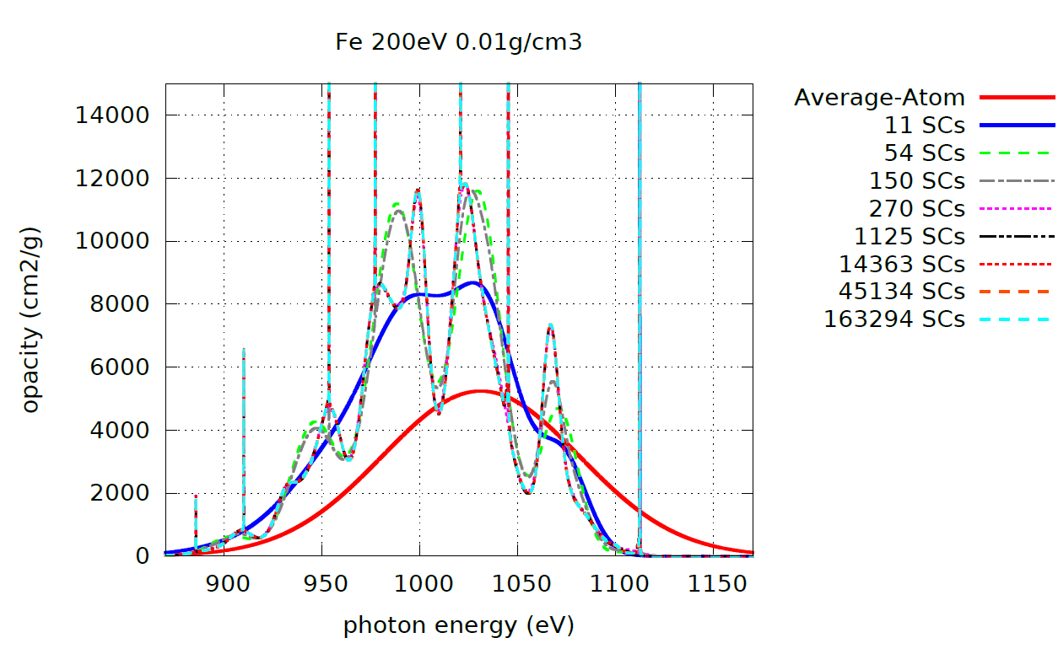
The Super-Transition-Array (STA) Method

Slide 38
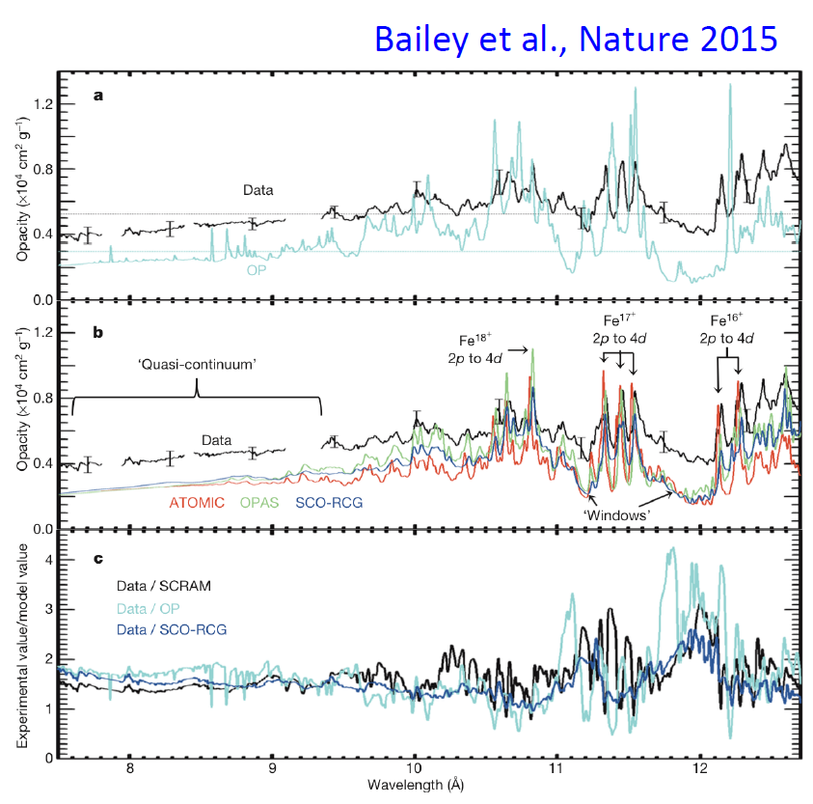
Wrong opacity?
(Very) recent progress:
• Opacity is being measured at stellar interiors
Conditions (see Bailey et al., Nature 2015).
• Monochromaic opacity is higher than expected for iron up to a factor of two!
Fe @ 182eV (!!!) 0.17g/cc

Slide 39
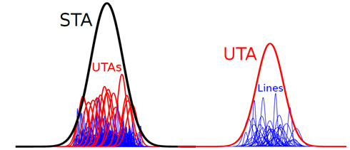
UTA moments
Occupation numbers
polynomials
Super configuration averaging
Partition function algebra
Partition Function

Slide 40
Interactions
Zero Order
Single particle states
Example: C=(3d )³(4f )⁷
g=2.3 million slater determinants
34,748 Levels
FAC: 48 minutes
Term splitting
Huge number lines
Slater Determinants
Configurations
Huge
Degeneracy

Slide 41
Example: C=(3d )³(4f )⁷
g=2.3 million slater determinants
34,748 Levels
FAC: 48 minutes

Slide 42
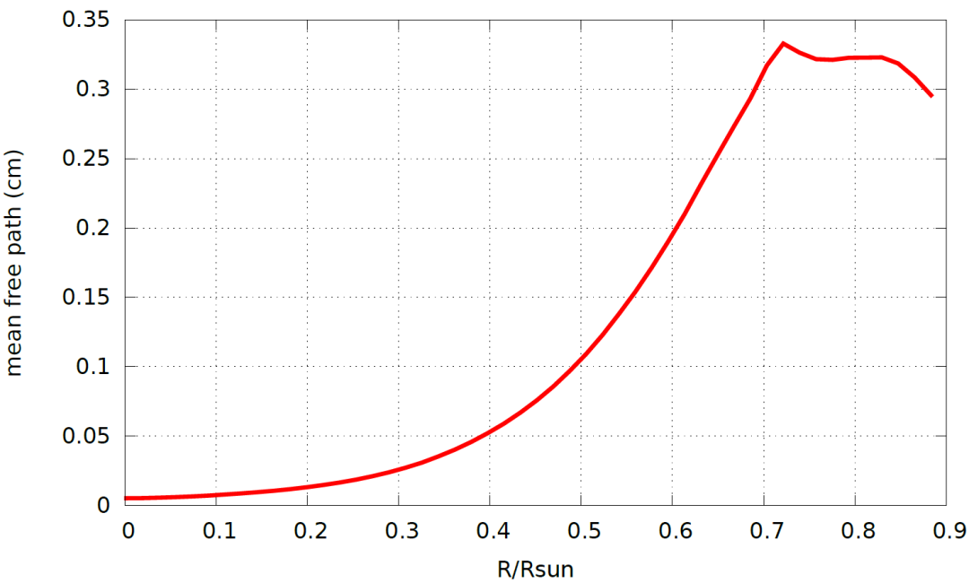
Photon Mean Free Path ~ 1cm
Tescape ~ 10^5 years
Photon
Mean Free Path

Slide 43
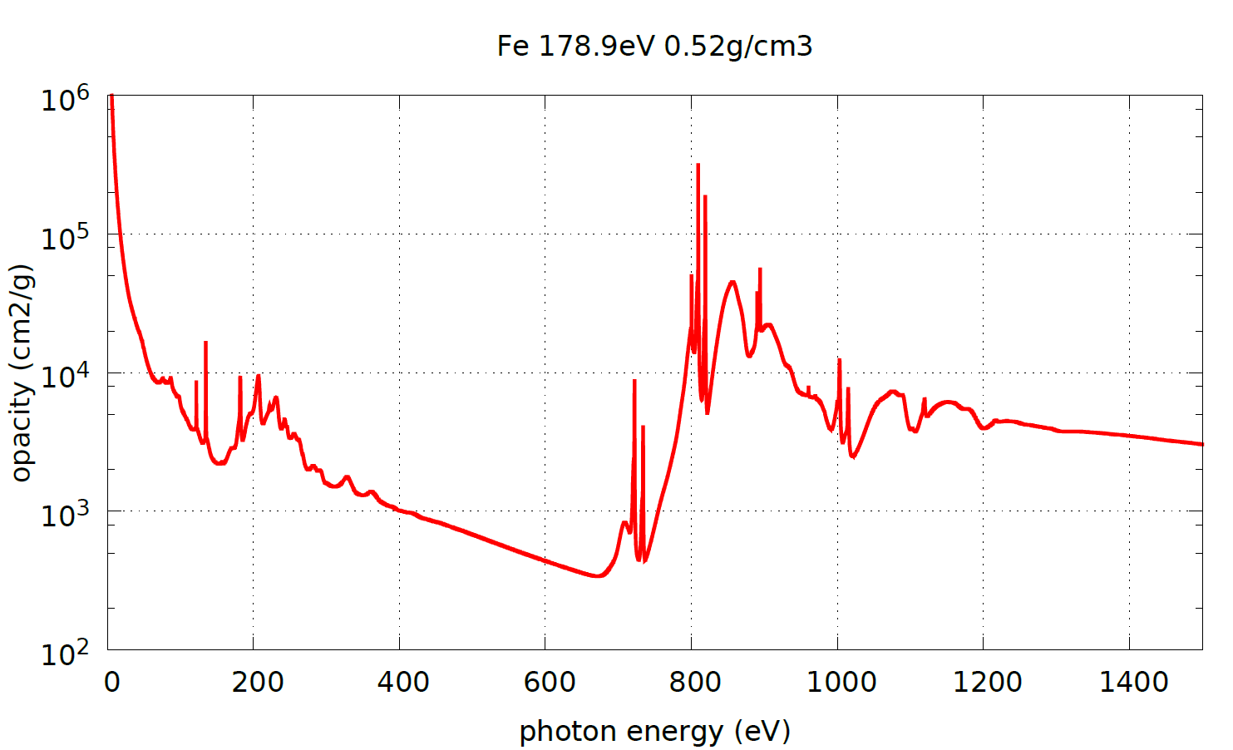
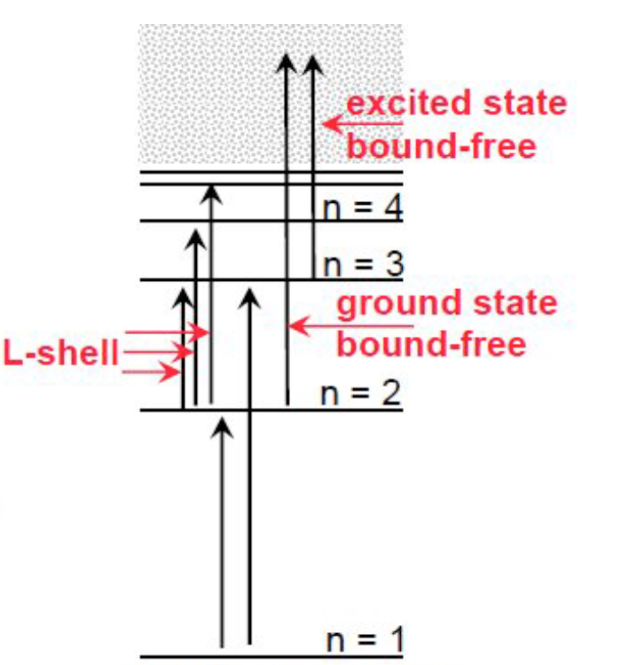
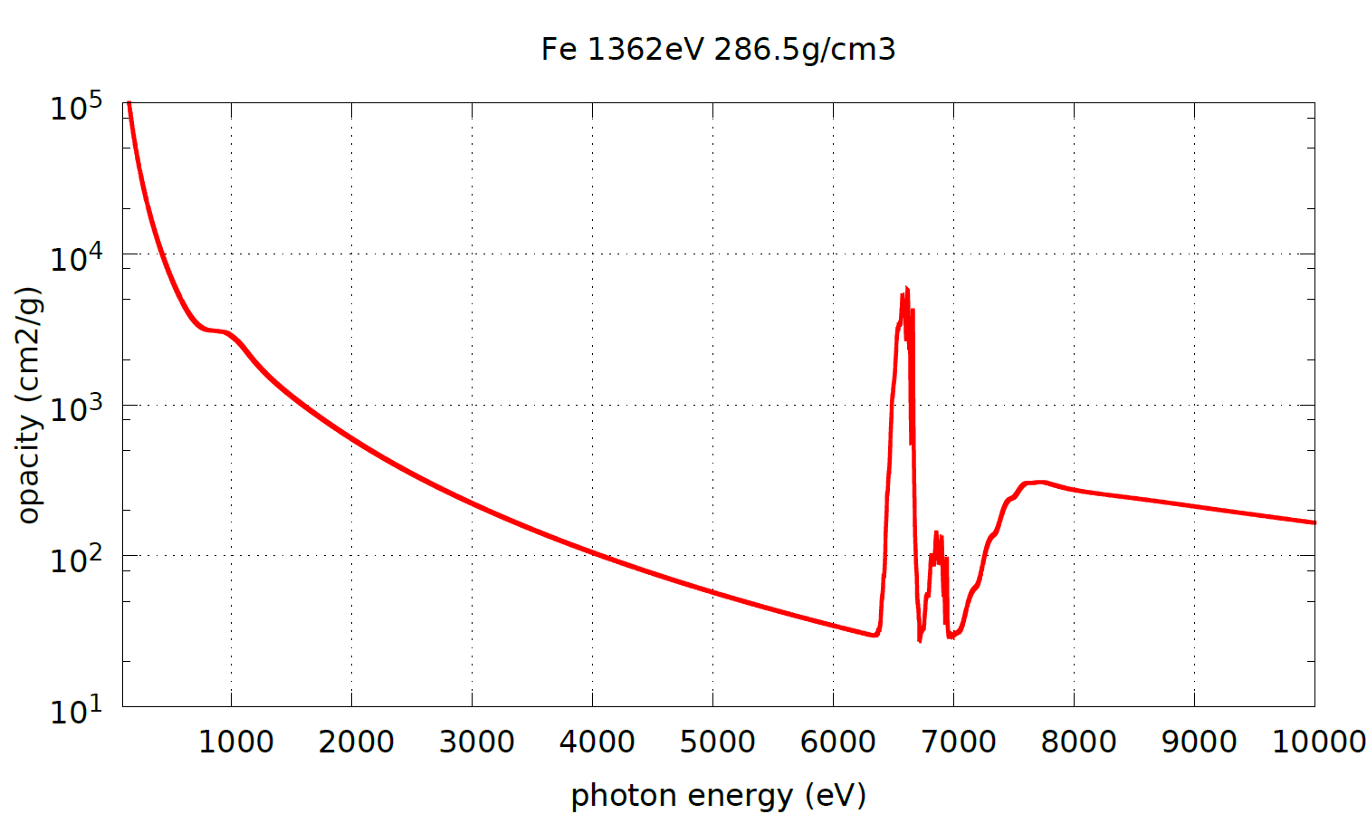
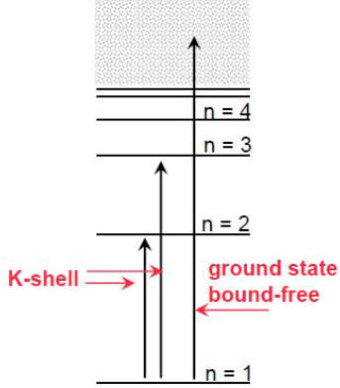
Convection Zone R=0.72
M shell
L shell
Sun Centre
R=0
K shell
L shell

Slide 44
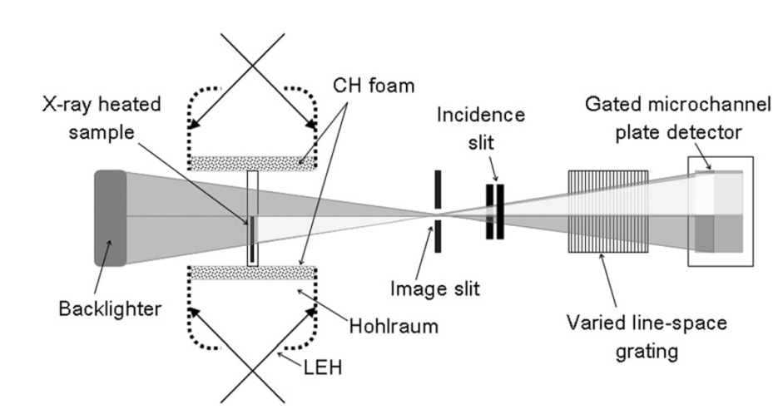
Transmission exp. Gold @ 85eV, 0.02g/cc
M. Krief, A. Feigel, HEDP 15 2015 59–66

Slide 45
Line broadening
Oxygen
R=0.72Rs
Magnesium
R=0.72Rs
Iron
R=0.25Rs
Silicone
R=0.25Rs

Slide 46
Average Atom – Liberman Model
Liberman 1979
Wilson 2006
Input: Temperature
Density
Z
Output:
Key atomic quantities
Dirac eqn. for
Bound & Free States
Self
Consistent
Calculation
Fermi Dirac statistics
Neutrality

Slide 47
M. Krief, A. Feigel, and D. Gazit, “Line broadening and the solar opacity problem”, arXiv:1603.01153 2016 (accepted for publication in ApJ)
M. Krief, A. Feigel, and D. Gazit, “Solar opacity calculations using the super-transition-array method” ApJ , 821:45, 2016
M. Krief, A. Feigel “Variance and shift of transition arrays for electric and magnetic multipole transitions”, HEDP 17 2015 254–262
M. Krief, A. Feigel “The effect of first order superconfiguration energies on the opacity of hot dense matter”, HEDP 15 2015 59–66

